Slide 1
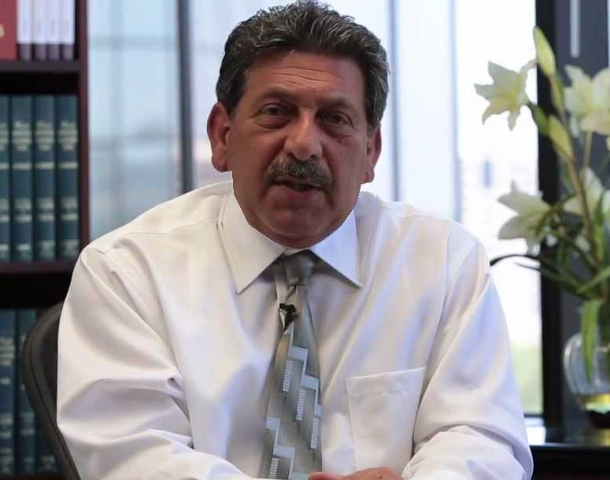
Tax Resolution
presented by
Peter Y. Stephan
Managing Partner – SST CPAS INC/Director of the Tax Resolution Institute

Slide 2
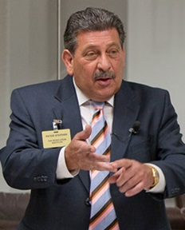
TRI
Tax Resolution Institute
About Peter…
SST CPAS INC
Certified Public Accountants
Peter Stephan built SST CPAS and the Tax Resolution Institute as firms with a unique blend of skills in accounting, taxation and business consulting for small to middle-sized companies and individuals in diverse industries.
In addition to specializing in the area of tax resolution, TRI and SST provide an array of specialized tax services for businesses, high-level financial groups, trusts, publicly traded companies, closely held entities, high net worth individuals and startups.
In addition to teaching tax resolution to his fellow professionals, Mr. Stephan is frequently retained by other CPAs and attorneys to provide forensic accounting and litigation support services including expert witness testimony relating to various accounting, fraud and tax compliance matters.
Peter Y Stephan, CPA
Director/Managing Partner
peter@ssttax.com
(800) 658-7590 / (818) 704-1443
www.taxresolutioninstitute.org

Slide 3
The TRI/SST Management Team
TRI
Tax Resolution Institute
SST CPAS INC
Certified Public Accountants
(800) 658-7590 / (818) 704-1443
www.taxresolutioninstitute.org

Slide 4
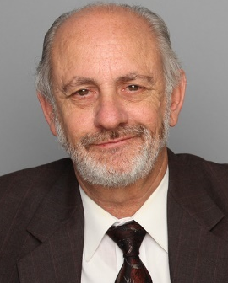
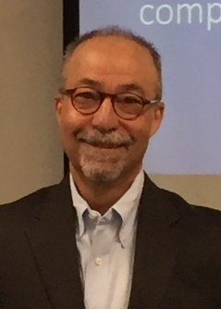
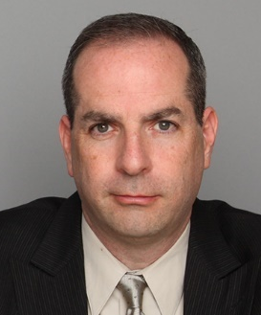
The “Key” Players
TRI
Tax Resolution Institute
SST CPAS INC
Certified Public Accountants
Peter Y. Stephan, CPA
Managing Partner
35+ years experience
Charles Tabachnick, CPA
Partner
35+ years experience
Norman J. Kreisman, Esq,
Head of Legal Dept.
25+ years experience
Matthew S. Cohen
Chief Strategy Officer
20+ years experience
(800) 658-7590 / (818) 704-1443
www.taxresolutioninstitute.org

Slide 5
You already know that the Tax Resolution Institute practices TAX RESOLUTION and TAX CONTROVERSY…
Offers in compromise
Installment agreements
Complex income tax audits
Penalty abatement
Subordination agreements
Innocent spouse relief
Withdrawal of tax liens
Subordination of tax liens
Certificate of Release of Federal tax liens
Tax dischargeability analysis for bankruptcy
(800) 658-7590 / (818) 704-1443 www.taxresolutioninstitute.org

Slide 6
TRI
Tax Resolution Institute
SST CPAS INC
Certified Public Accountants
WHY DO WE PRACTICE TAX RESOLUTION?
(800) 658-7590 / (818) 704-1443
www.taxresolutioninstitute.org

Slide 7
26 Million of 153 Million U.S. taxpayers…
Can’t afford to pay the IRS
or disagree with the amount they owe
(800) 658-7590 / (818) 704-1443 www.taxresolutioninstitute.org

Slide 8
Number of Accounts in IRS Collection
Year | Accounts in Collection | Increase (%)
2015 | 13,371,000 | 7.83%
2014 | 12,400,000 | 5.79%
2013 | 11,721,000 | 2.24%
2012 | 11,464,000 | 6.06%
2011 | 10,809,000 | 4.02%
2010 | 10,391,000 | 7.49%
2009 | 9,667,000 | 4.71%
2008 | 9,232,000 | 12.04%
2007 | 8,240,000 | 16.48%
2006 | 7,047,000 | -
(800) 658-7590 / (818) 704-1443 www.taxresolutioninstitute.org

Slide 9
TRI
Tax Resolution Institute
SST CPAS INC
Certified Public Accountants
…and this is how we do it!
(800) 658-7590 / (818) 704-1443
www.taxresolutioninstitute.org

Slide 10
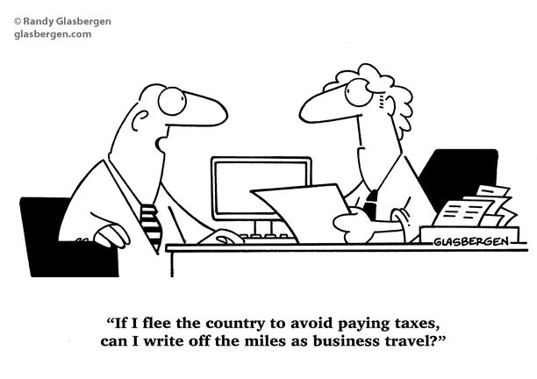
TRI
Tax Resolution Institute
SST CPAS INC
Certified Public Accountants
(800) 658-7590 / (818) 704-1443
www.taxresolutioninstitute.org

Slide 11
TRI
Tax Resolution Institute
SST CPAS INC
Certified Public Accountants
Installment Agreement
Success Stories

Slide 12
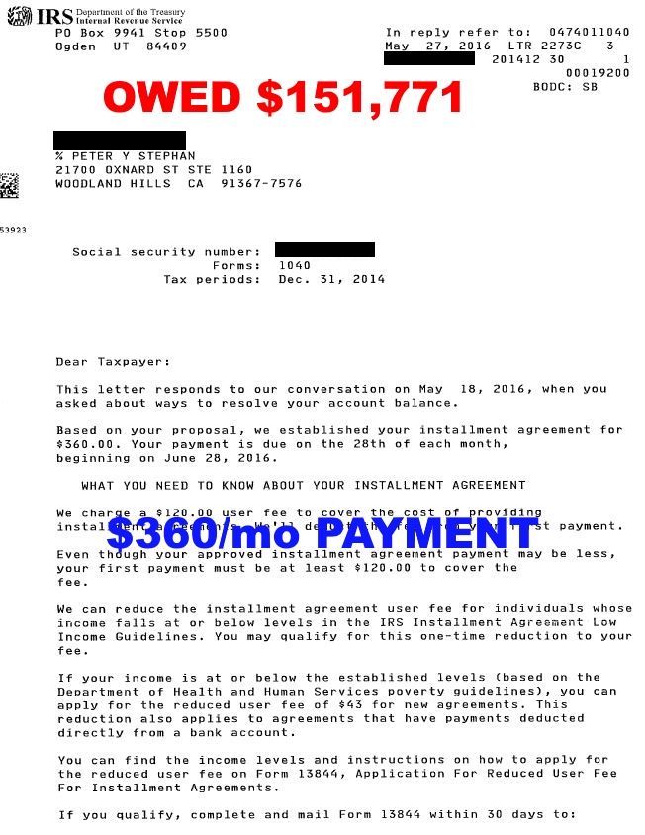
IRS Installment Agreement

Slide 13
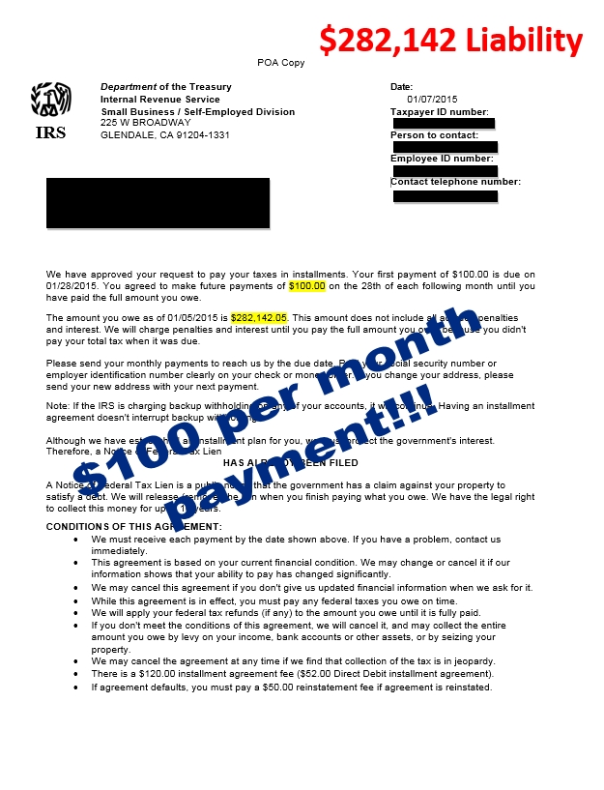
IRS
Partial Pay Installment Agreement

Slide 14
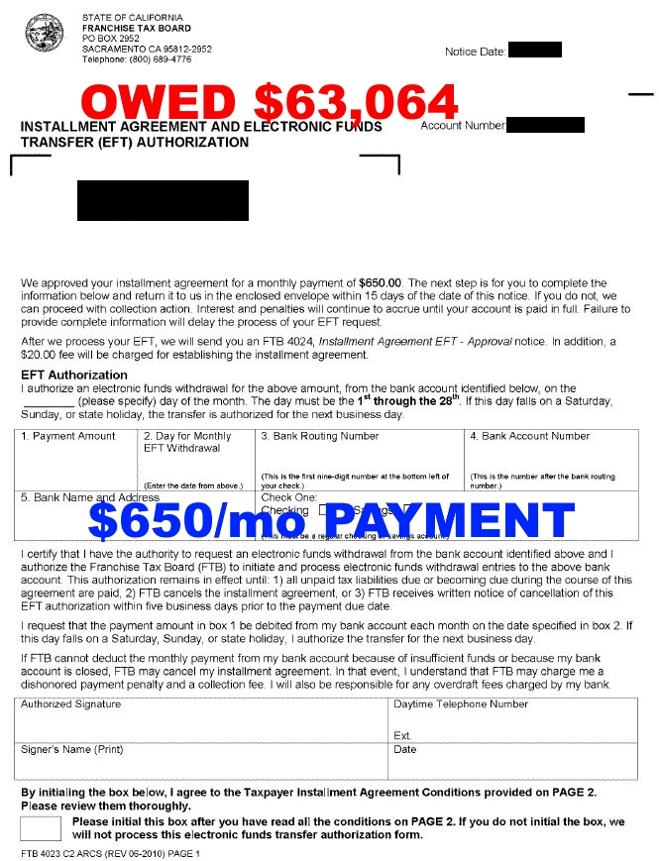
CA FTB Installment Agreement

Slide 15
TRI
Tax Resolution Institute
SST CPAS INC
Certified Public Accountants
Offer in Compromise
Success Stories…

Slide 16
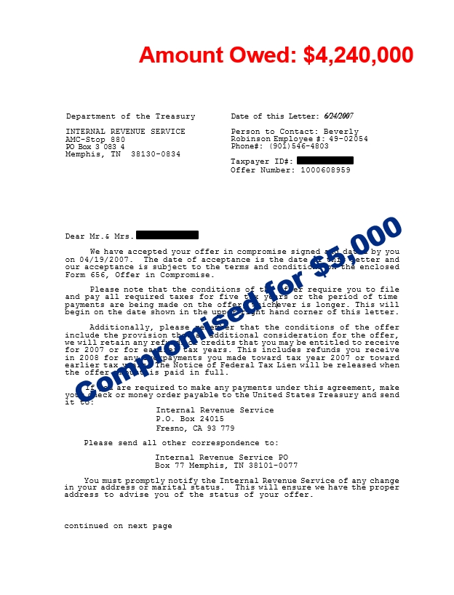
IRS
Offer in Compromise

Slide 17
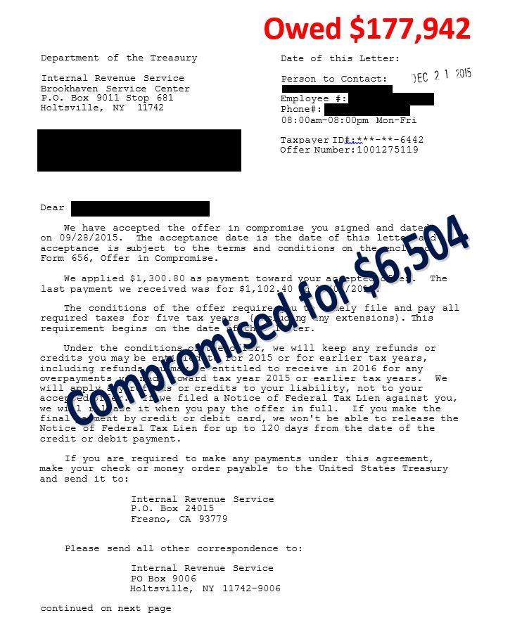
IRS
Offer in Compromise

Slide 18
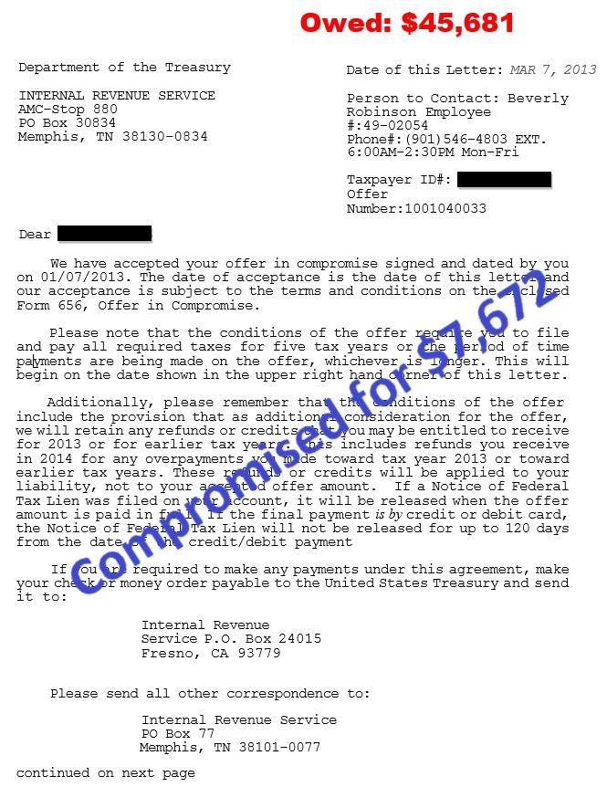
IRS
Offer in Compromise

Slide 19
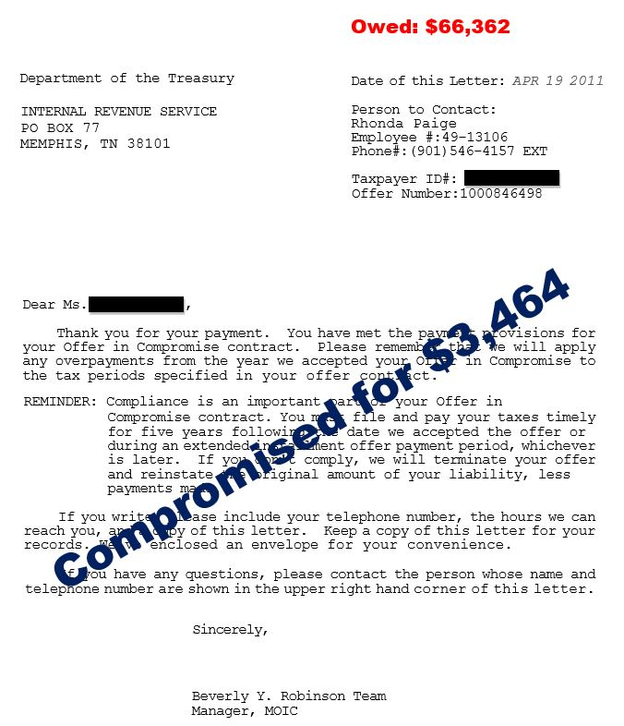
IRS
Offer in Compromise

Slide 20
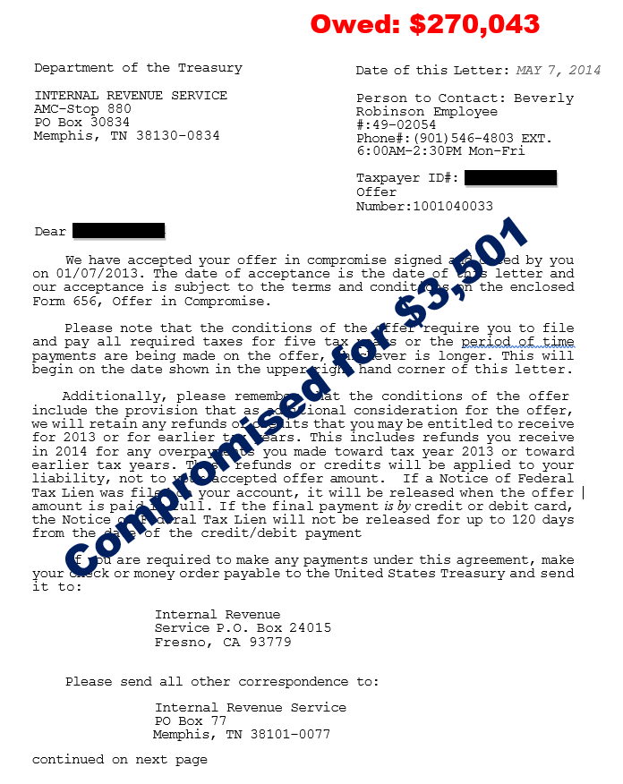
IRS Offer…
accepted and then rejected for nonpayment

Slide 21
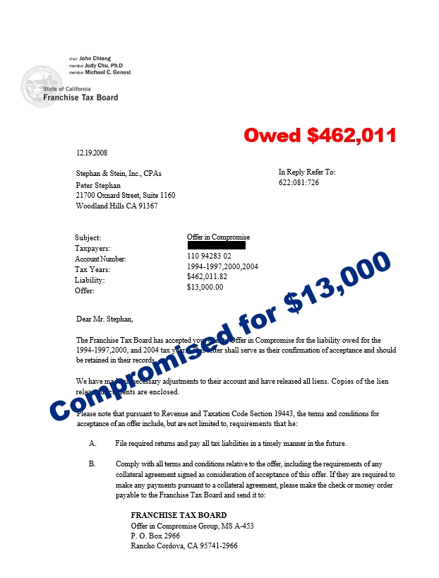
California FTB Offer in Compromise

Slide 22
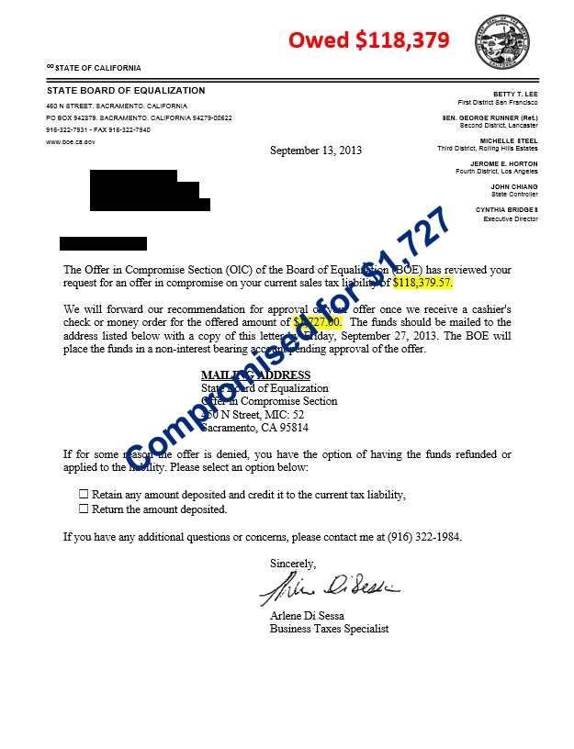
California
State Board of Equalization (sales tax) Offer in Compromise

Slide 23
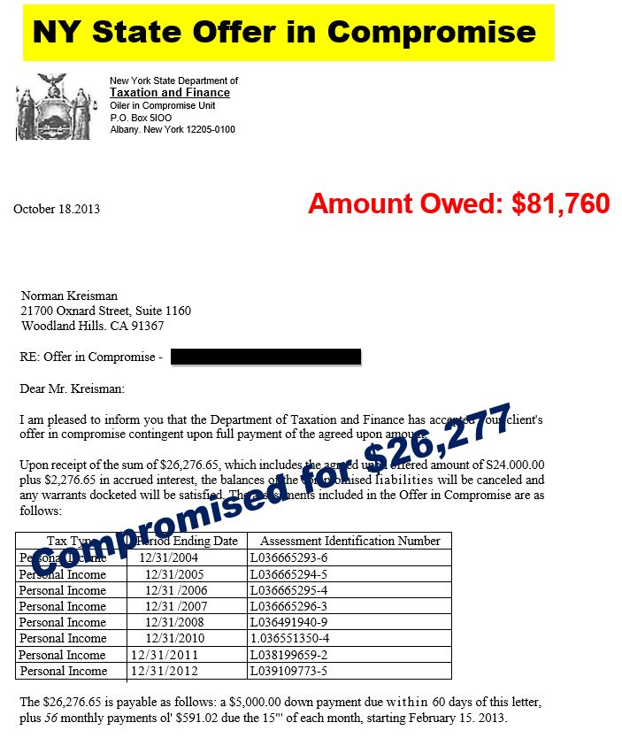
New York DTF
Offer in Compromise

Slide 24
What you may not know if at SST CPA’S we handle…
Over 1,000 Business and individual tax returns
Compiled and reviewed financial statements
Tax appeals including petitioning the US Tax Court
and much more…
(800) 658-7590 / (818) 704-1443 www.taxresolutioninstitute.org

Slide 25
We are your one-stop shop for all accounting, tax and consulting needs
TRI
Tax Resolution Institute
SST CPAS INC
Certified Public Accountants
(800) 658-7590 / (818) 704-1443
www.taxresolutioninstitute.org

Slide 26
The way we do anything… is the way we do everything
TRI
Tax Resolution Institute
SST CPAS INC
Certified Public Accountants
(800) 658-7590 / (818) 704-1443
www.taxresolutioninstitute.org

Slide 27
TRI
Tax Resolution Institute
SST CPAS INC
Certified Public Accountants
I’m Peter Stephan….
(800) 658-7590 / (818) 704-1443
www.taxresolutioninstitute.org

Slide 28
TRI
Tax Resolution Institute
SST CPAS INC
Certified Public Accountants
…and this is TRI
(800) 658-7590 / (818) 704-1443
www.taxresolutioninstitute.org

Slide 29
TRI
Tax Resolution Institute
SST CPAS INC
Certified Public Accountants
Find us on the web at: www.taxresolutioninstitute.org
Email us at: info@taxresolutioninstitute.org
Call us at: (800) 747-8718

