Slide 1
“Busy Season”
…all year long
TRI Tax Resolution Institute
…where your client’s tax debt is your power!
(800) 658-7590 www.taxresolutioninstitute.org

Slide 2

Tax
Tax &
More tax

Slide 3

Meet our speaker
Peter Y. Stephan, CPA
(800) 658-7590 www.taxresolutioninstitute.org

Slide 4
Tax Tax and More Tax
Why are we here today?
The Tax Resolution Institute prides itself in assisting accounting, legal and other professionals resolve their client’s tax problems and grow their businesses
Take advantage of one of our many programs
We help you make more money
We teach you how to become a tax resolution specialist
We become your partner working side-by-side to fix your client’s IRS and State income, payroll (collection issues) and tax audit issues
Or…we become your trusted referral source
(800) 658-7590 www.taxresolutioninstitute.org

Slide 5
What will be covered today
Tax Cuts and Jobs Act
Grow your practice with Tax Resolution
Marketing for professionals
DRAWING – Professional’s System
Resolution case management
Payroll Taxes
Installment agreements
Case study: installment agreement
Offers in compromise
Selling your professional services
DRAWING – Professional’s System
Case study: OIC vs IA
IRS criminal investigation
Innocent Spouse
Taxes and bankruptcy
Audits
Appeals
5
(800) 658-7590 www.taxresolutioninstitute.org

Slide 6
Have you downloaded your materials?
The following materials and more will be available to seminar/webcast attendees at www.taxresolutioninstitute.org for 10 days without being a member:
A copy of today’s presentation
Tax resolution flow chart (“cheat sheet”)
Tips and traps pertaining to Installment Agreements
Tips and Traps pertaining to Offers in Compromise
First time penalty abatement instructions (FTPA)
IRS contact numbers
IRS 4180 Interview form
…and more
6
access your free content at www.taxresolutioninstitute.org/200A

Slide 7
Tax Cuts & Jobs Act
What You Need to Know
TRI Tax Resolution Institute
…where your tax debt is your power!

Slide 8
History of Federal Income Tax
First imposed in 19th century to fund Civil War (3% of income or $600...rescinded in 1872)
Legality of income tax was questioned until passing of 16th amendment in 1913
Income tax rates in 1913 were 1% on income over $3k 7% for income over $500k ($12,122,000 in 2016 dollars)
To finance WWI in 1918, the highest marginal tax rate increased to 77% for income over $1MM ($17,264,599 in c2016 dollars)

Slide 9
History of Federal Income Tax (continued)
In 1932 the highest marginal rate increased to 63% and continued upward ultimately reaching 94% (on income over $200,000)
Required withholding and quarterly payments began in 1945
The highest marginal rate hovered around 90% until 1964 at which time the rate was lowered to 70%
The marginal rate maximum was lowered again to 50% in 1982 and 28% in 1988
Since 1988 the marginal rate maximum has slowly increased to 39.6%

Slide 10
Maximum Tax Rates by Time Period (MFJ)
 | Maximum
Tax Year/s | Tax Rate |  | Income Threshold*
1944 - 1945 | 94.0% |  | over | 200,000
1953 | 92.0% |  | over | 400,000
1954 - 1963 | 91.0% |  | over | 400,000
1964 | 77.0% |  | over | 400,000
1965 - 1981 | 70.0% |  | over | 215,400
1982 - 1986 | 50.0% |  | over | 175,250
1987 | 38.5% |  | over | 90,000
1988 - 1990 | 28.0% |  | over | 32,450
1991 - 1992 | 31.0% |  | over | 86,500
1993 -2000 | 39.6% |  | over | 288,350
2001 | 39.1% |  | over | 297,350
2002 | 38.6% |  | over | 307,050
2003 - 2012 | 35.0% |  | over | 311,950
2013 - 2017 | 39.6% |  | over | 450,000
* threshold amounts shown are for latest year in the span
Historical Tax Rates

Slide 11
2018 Tax Brackets & Rates
Rate | MFJ | MFS | Single | HOH
10% | $0 – 19,050 | $0-$9,525 | $0-$9,525 | $0-$13,600
12% | $19,050 - $77,400 | $9,526-$38,700 | $9,526-$38,700 | $13,601- $51,800
22% | $77,401-$165,000 | $38,701- $82,500 | $38,701-$82,500 | $51,801-$82,500
24% | $165,001-$315,000 | $82,501- $157,500 | $82,501- $157,500 | $82,501-$157,500
32% | $315,001-$400,000 | $157,501-$200,000 | $157,501-$200,000 | $157,501-$200,000
35% | $400,001-$600,000 | $200,001-$300,000 | $200,001-$500,000 | $200,001-$500,000
37% | $600,001 and over | $300,001 and over | $500,001 and over | $500,001 and over

Slide 12
2018 Personal Exemptions - GONE
Tax Cuts and Jobs Act | Previous Law
$0 | $4,150

Slide 13
Deductions that went away
Moving Expense Deduction has been eliminated as well as the Exclusion from Income for qualified moving expense reimbursements provided by an Employer
Alimony is no longer deductible by the payor spouse nor is it included in the recipient spouse's gross income for any divorce or separation instrument executed after December 31, 2018.
Student Loans – New Cancellation of Debt exclusion (the deduction for student loan interest remains. A student loan discharged on account of death or total disability of the student is excluded from gross income, but only if the discharge of indebtedness occurs prior to January 1, 2026)
Notes:
Student Loans – New Cancellation of Debt exclusion The deduction for student loan interest remains. A student loan discharged on account of death or total disability of the student is excluded from gross income, but only if the discharge of indebtedness occurs prior to January 1, 2026.

Slide 14
2018 Standard Deduction - Increased
Filing type | Tax Cuts and Jobs Act | Previous law
MFJ (and surviving spouse) | $24,000 | $13,000
Head of household | $18,000 | $9,550
Single (and MFS) | $12,000 | $6,350

Slide 15
Medical Expenses
Medical Expense Deduction reduced to 7.5% of AGI for 2017 and 2018 for all taxpayers.
Returns to 10% of AGI after 2018.

Slide 16
Deduction for State and Local Taxes (SALT)
Itemized Deduction up to $10,000 ($5K for MFS) for the aggregate of state and local income taxes and property taxes.
SALT and property taxes paid while engaged in a trade or business, a rental activity, or an activity described in Internal Revenue Code §212 remain fully deductible.
Taxpayers retain the ability to choose between state income taxes and sales taxes.
The $10,000 limitation for individuals also applies to estates and trusts.

Slide 17
Mortgage Interest
From Jan 1, 2018 – Dec 31, 2025 no more than $750,000 ($375,000 for MFS) can be treated as acquisition indebtedness.
If the acquisition indebtedness was incurred before Dec 15, 2017, the $1 million limitation ($500K for MFS) is grandfathered in, along with any refinancing of grandfathered debt.
Once the law expires on Dec 31, 2025, all mortgage debt (including debt acquired after Dec 15, 2017) will be subject to the $1 million limitation.
Interest from all Home Equity Indebtedness is Non-Deductible from Jan 1, 2018 to Dec 31, 2025.

Slide 18
Second Homes
No change on Second Homes except the lower overall cap ($750K from $1 Million)

Slide 19
Charitable Contributions
AGI Limit has been increased to 60% from 50% for charitable contributions to 50% Charities.

Slide 20
Casualty Losses
Casualty losses are no longer deductible unless it is a “Presidentially-Declared Disaster”.
Any allowable casualty loss deductions are still deductible as itemized deductions and subject to the $100 per casualty and 10% of AGI limitations.

Slide 21
Miscellaneous Itemized Deductions
All miscellaneous itemized deductions subject to the 2% floor are repealed.
This includes:
  Tax preparation fees (unless they can be allocated to Schedules C, E, or F).
  Unreimbursed employee business expenses.
  Union dues and uniforms.
  Investment advisor fees and/ or asset management fees.

Slide 22
Capital Gains – No Substantial Change
Individual Long-Term Capital Gains Rates
Rate | Tax bracket (for 2017) | Income level breakpoint (for 2018)
0% | 10% and 15% | Single: $38,600 MFS: $38,600 MFJ: $77,200 HOH: $51,700
15% | 25%-35% | Single: $425,800 MFS: $239,500 MFJ: $479,000 HOH: $452,400
20% | 39.6% | No breakpoint

Slide 23
Alternative Minimum Tax
2018 AMT Exemption Amounts
Filing Status | Tax Cuts and Jobs Act | Previous Law
Single, HOH | $70,300 | $55,400
MFJ, surviving spouse | $109,400 | $86,200
MFS | $54,700 | $43,100
Beginning of 2018 AMT Exemption Phase-out Ranges
Filing Status | Tax Cuts and Jobs Act | Previous Law
Single, HOH | $500,000 | $123,100
MFJ, surviving spouse | $1,000,000 | $164,100
MFS | $500,000 | $82,050

Slide 24
Retirement Plan Changes
No longer able to re-characterize Roth IRA contributions as traditional IRA contributions to unwind a Roth Conversion.
Allows employees whose retirement plan terminates or who separate from employment while they have outstanding plan loans to contribute the loan balance to an IRA by the due date for filing their tax return, including extensions, for that year in order to avoid the loan being taxed as a distribution.

Slide 25
Other Provisions
Net Operating Loss Carrybacks have been largely repealed, and Net Operating Loss carryovers are limited to 80% of the taxpayer’s taxable income for the year of the claimed deduction (starting in 2018), but carryovers are allowed indefinitely.
Cost of Living Adjustments are now made under Chained CPI
Distributions from §529 accounts are allowed in connection with K-12 Education, up to $10,000.
New due diligence requirements for HoH filing status, including $500 penalty for failure to perform due diligence.

Slide 26
Deduction for “Pass-through” Entities
IRC §199A deduction
Qualified businesses may deduct up to 20% of business income for 2018.
Qualified business income excludes W-2 income and partner guaranteed payments.
Deduction applies to:
  Sole proprietors
  Partnerships (via K-1)
  S corporations (via K-1)
  Trusts and estates
No deductions for C-Corps (or LLCs taxed as a C-Corps).

Slide 27
Where it will be deducted?
The deduction is NOT taken when computing AGI.
The deduction is allowed for both itemizers and non-itemizers.
The deduction applies for Income Tax purposes only
The deduction is taken after either the standard deduction or an itemized deduction.
Adjusted Gross Income
Less: Standard Deduction or Itemized Deductions
Taxable Income before IRC §199A deduction
Less: IRC §199A deduction
Taxable Income

Slide 28
IRC §199A Deduction Limitations
The deduction is limited to 20% of the lesser of Net Qualified business income and taxable income before the deduction
Taxable Income Limitations
 | Jane | Sam
Net qualifying business Income (NBI) | $100,000 | $100,000
Taxable Income before IRC §199A | $140,000 | $70,000
Taxable income (TI) | $140,000 | $70,000
Lesser of (NBI) or (TI) | $100,000 | $70,000
IRC §199A deduction (20% of above) | $20,000 | $14,000

Slide 29
IRC §199A Deduction Limitations
Taxable income must exclude capital gains
If qualified business has capital gains, they are subtracted from taxable income prior to calculating 199A deduction
Taxable Income Limitations (with and without capital gains)
 | Sam | Jack
Net qualifying business Income (NBI) | $100,000 | $100,000
Taxable Income before IRC §199A | $120,000 | $120,000
Capital gains | $0 | $30,000
Taxable income less capital gains (TINCG) | $120,000 | $90,000
Lesser of (NBI) or (TINCG) | $100,000 | $90,000
IRC §199A deduction (20% of above) | $20,000 | $18,000

Slide 30
Phase-out Ranges
The phase-out affects "specified" service business differently than other businesses.
Although the effect of the phase-out is different, the phase-out ranges for all qualified taxpayers is the same.
  Married filing joint: $315,000-$415,000; and
  All other filing statuses: $157,500-$207,500.

Slide 31
Phase-outs for “specified” service business
The new tax law phases out the 199A deduction for most service based businesses.
Service businesses (defined later) with income above the upper range, lose the entire deduction.
Service businesses within the phase-out range, with receive a partial deduction.

Slide 32
Service Businesses
Defined under IRC §199A(d)(2)
A "specified service trade or business” is any business that performs services
Engineers and architects are exempted from this category.
Examples of service-based businesses:
  Investment activity and management professionals
  Doctors, nurses, and dentists
  Attorneys
  Accountants (including tax preparers)
  And many more including performing artists, consultants; and athletics professionals.

Slide 33
Service Businesses Continued
In case you are unsure about a which trade or business is “specified”…
The “Services” category includes “any trade or business where the principal asset of such trade or business is the reputation or skill of one or more of its employees.”
This is a pretty far-reaching definition

Slide 34
Example of Phase-outs for service business
 | Brad | Barbara | Bill
Net qualifying business income (NBI) | $100,000 | 200,000 | 100,000
Taxable income before IRC §199A (TI) | $90,000 | $220,000 | $167,500
Lesser of (NBI) or (TI) | $90,000 | $200,000 | $100,000
IRC §199A deduction before phase-out | $18,000 | $40,000 | $20,000
Phase-out | $0 | $40,000 | $4,000
IRC §199A deduction | $18,000 | $0 | $16,000
Note the following:
Brad, Barbara, and Bill all operate tax practices as sole proprietors (with varying degrees of success). All are single. None have any capital gains.
Brad is allowed the full deduction because his taxable income before the deduction is below the lower threshold of the phase-out range;
Barbara's deduction is fully phased out because her taxable income before the deduction is over the upper end of the phase-out range; and
Bill's deduction is partially phased out. His taxable income is $10,000 over the initial range ($167,500- $157,500). The total phase-out range is $50,000 ($157,000-$207,500). Therefore, his phase-out is 20% of his initial deduction ($10,000 + $50,000). His phase-out is $4,000 (20% x $20,000).

Slide 35
Phase-outs for all other businesses
If a non service business exceeds the top phase-out level for business income they may retain all are part of the deduction subject to other limitations.
To illustrate, if taxpayer's income exceeds the phase-out thresholds, the deduction amount is determined using employee wages paid by the business as well as the basis (unadjusted) of depreciable property held by the business.
In the illustration, the deduction is limited to the GREATER of:
  50% of the W-2 wages paid by the business; or
  The sum of:
    25% of the W-2 wages paid by the business; plus
    2.5% of the unadjusted basis immediately after acquisition of depreciable property

Slide 36
Example of phase-outs for non-service businesses
 | Jack | Linda | Angela
Net qualifying business income (NBI) | 400,000 | 400,000 | 400,000
Taxable income before IRC §199A (TI) | 400,000 | 400,000 | 400,000
Lesser of (NBI) or (TI) | 400,000 | 400,000 | 400,000
IRC §199A deduction (20% of above) | 80,000 | 80,000 | 80,000
W-2 wages paid | 0 | 300,000 | 100,000
Unadjusted basis of depreciable assets | 1,000,000 | 0 | 400,000
50% of W-2 | 0 | 150,000 | 50,000
25% of W-2 + 2.5% of assets | 25,000 | 75,000 | 35,000
Allowable deduction | 25,000 | 80,000 | 50,000
Jack, Linda, and Angela are all in the business of producing clothing. All are single. None have any capital gains. They all operate as sole proprietorships.
Jack has depreciable property but has no employees.
Linda has employees but rents her building and all of her equipment.
Angela has employees and depreciable property.

Slide 37
What counts as “Qualified Business Income”
Qualified Business Income is comprised of “the net amount of qualified items of income, gain, deduction, and loss with respect to any qualified trade or business of the taxpayer.”
Income must originate from the United States and US territories including W-2 wages and depreciable property
Qualified business income excludes dividends, capital gains and interest income.
Gains on the disposition of assets is considered qualified business income and is treated as ordinary income (IRC §1231 gains).

Slide 38
Does rental real estate count as qualified business income?
Rental income from real estate shown on Schedule ‘E’ DOES COUNT as qualified business income.
Multiple rental properties
  Although not specified in the new tax law, it seems likely that owners of multiple rental properties will want to treat the rental properties as a single trade or business, even if they have not made the single activity election.
  It remains to be seen how the IRS will treat rental income from other sources (i.e. pass-through entities via K-1’s) with rental properties owned directly by the taxpayer.

Slide 39
Multiple Rental Properties Example
Jeffery owns 3 single-family homes that are currently rented. He is single and his taxable income for the year is $100,000. For 2018, his net rental income (loss) is:
Property 1: 20,000
Property 2: 10,000
Property 3: (5,000)
Combined income/(loss): 25,000
Without considering outside limitations, Jeffery’s deduction would be $5,000 (20% x $25,000).

Slide 40
Suspended Passive Losses
If a rental real estate owner generates suspended passive losses that are released in the current year, they will reduce the amount of qualified business income from the rentals.
Multiple rental properties (example 2)
Using the fact provided in the previous example, if Jeffery also has $10,000 of suspended passive losses that will be carried over from 2017, his net income from the properties is reduced to $15,000 and his deduction would be $3,000 (20% x $15,000) instead of $5,000.

Slide 41

Become a VIP Member
Ultimate VIP Members have access to:
3 hours of Consultation Time
Video On Demand Library
All of our E-Learning Courses
Access to our IRS Forms Library (No need to hunt for the Tax Resolution Forms you need)
Access to White Papers and Case Studies
And much more!
FREE 60 Day Trial
Look in your chat box now for the link to sign up!

Slide 42
Property Sales
If a taxpayer sells rental real estate, gains to the extent of IRC §1250 recapture would be considered qualified business income.
Gain treated as capital gains; however, would not be qualified business income.

Slide 43
Business income from flow-through entities
The deduction for owners with interests in flow-through entities will be determined at the individual level using information reported on Schedule K-1.
This means that K-1’s must now show an allocation of employee wages paid by the entity attributable by the “owner” as well as their portion of income/loss.
The same holds true for their allocable portion of the unadjusted basis of qualifying depreciable property.
Read….lots of new work for accountants AND taxpayers!

Slide 44
Partners and partnerships
A partner's guaranteed payment from a partnership or other pass-through entity is NOT considered qualified business income to the partner.
Moreover, it reduces qualified business income. IMPORTANT
Example of guaranteed payments
Bob and Stu are each 50% partners in their business. The income for each is lower than the taxable lower income phase-out threshold.
Each receives a guaranteed payment for $50,000. In addition, each is allocated $30,000 as their share of the partnership’s ordinary income.
Each partner will receive a deduction in the amount of $6,000 (20% x $30,000).
Note that had they not received any guaranteed payments, they each would have been allocated $80,000 in income, and qualified for a $16,000 199A deduction (20% x $80,000).

Slide 45
S Corporations
Owners wages do not count as qualified business income.
Example of S corporation wages
David had a sole proprietorship that is a non-service trade or business. He has net income on his Schedule C in the amount of $500,000. He had no other income. He pays no wages and has qualifying depreciable assets of $100,000.
Because David’s income is over the phase-out threshold and he pays no wages to employees, his deduction would be limited to $2,500 (2.5% x $100,000 depreciable assets).
David incorporates the business and makes an S election. He pays himself a salary of $200,000, leaving $300,000 as flow-through income.
His 199A deduction in this case would increase to $60,000 (the lesser of 20% x $300,000 or 50% of the $200,000 W-2 amount).

Slide 46
Trusts, Estates, & Dividends
Trusts and estates
Trust and estates are treated the same as partnerships with regard to the 199A deduction.
Real Estate Investment Trust (REIT) dividends and qualified cooperative dividends
Qualified dividends and qualified cooperative patronage dividends count as qualified business income.
Capital gain distributions and C corporation dividends do not count.

Slide 47
Hybrid businesses (service & non-service)
Taxpayers under the lower taxable income phase-out threshold are treated the same regardless of whether their business is a service business or not.
The IRS has not provided guidance for hybrid businesses (part service and part non-service). Some possible options include:
  A threshold test (i.e. at least 80% of the businesses assets are used in the non-service vertical)
  Each vertical is treated separately using separate accounting for each. Items such as administrative overhead would be allocate accordingly

Slide 48
Example hybrid business income
David is a doctor operating his business as an S corporation.
In addition to providing services, the corporation sells products online.
David’s pass-through income from the corporation is $500,000 and his taxable income before the deduction is also $500,000.
He keeps accurate accounting of the separate activities and determines that of the $500,000 taxable income of the corporation, $50,000 is attributable to sales of online products. He also determines that $20,000 of the corporation's salary expense is properly allocated to sales of the online products.
David’s income is over the phase-out threshold for taking the deduction on income from a service business and receive no deduction.
However, if the IRS rules that a hybrid business may take the deduction on the non-service portion of the income, David’s 199A deduction would be $10,000 (the lesser of 20% x $50,000 or 50% x $20,000 wages, which in this example are the same).

Slide 49
Multiple trades or businesses
Generally, the 199A deduction is initially determined separately with respect to each trade or business the taxpayer has.
The deductions are then combined to determine the total deduction.

Slide 50
Determining deduction for multiple businesses
 | Law Practice | Rental | S corporation
(A) Net qualifying business income | $300,000 | $10,000 | $20,000
(B) Taxable income before IRC §199A | $370,000 | $370,000 | $370,000
Lesser of (A) or (B) | $300,000 | $10,000 | $20,000
IRC §199A deduction (20% of above) | $600,000 | $2,000 | $4,000
W-2 wages paid | N/A | $0 | $5,000
Unadjusted basis of depreciable assets | N/A | $1,000,000 | $20,000
50% of W-2 | N/A | $0 | $2,500
25% of W-2 + 2.5% of assets | N/A | $25,000 | $1,750
Allowable deduction | $0 | $2,000 | $2,500
Carl owns a law practice. His Sch C inc is $300k. He is single and has taxable income of $370k before the deduction He has no capital gains.
He has a rental property that generates $10,000 in rental income and depr property has unadj basis of $1MM
He is a S/H in an S corp that sells watches. His allocable inc from that business is $20k, his allocable W-2 amount is $5k, and his allocable share of depreciable assets is $20k.
Carl's total deduction is $4,500. He is not allowed a deduction with respect to income from his law practice because he is over the taxable income threshold.

Slide 51
Business Losses and the “Deduction Reduction”
Net business losses may come into play under two scenarios:
  If the taxpayer's overall net business income is less than $0; or
  If the taxpayer has more than one businesses, has combined net business income and at least one business has a loss.
Combined business loss
If the taxpayer’s combined business income is less than zero, no deduction will be allowed and the loss will be carried over to the following year.
Combined business income (with one or more business loss)
If the taxpayer has more than one business reflecting combined income, any loss from a the separate business/es activity will offset the deduction amount from the amount calculated on combined income. This in effect creates a "deduction reduction."

Slide 52
Business Loss Example
Irma and Steve file a joint return. They have taxable income before the 199A deduction in the amount of $200,000. This amount is under the lower phase-out thresholds.
Irma’s Schedule C earnings | $150,000
Steve’s Schedule C loss | ($40,000)
Carryover business loss from prior year | ($50,000)
Total business income | $60,000
Irma's deduction ($150,000 x 20%) | $30,000
Steve's deduction reduction ($40,000 x 20%) | ($8,000)
Carryover loss deduction reduction ($50,000 x 20%) | ($10,000)
Deduction | $12,000
Unanswered Questions
It appears that carryover losses accumulate and carry over indefinitely. It is not clear whether taxpayers will need to compute accumulated business losses from pre-enactment years and carry them into 2018.

Slide 53
2018 Changes
Matt runs a tax practice. He earns $100,000 net income in his practice reported on a Schedule C. He is single and uses the standard deduction.
 | 2018 | 2017
Schedule C income | $100,000 | $100,000
One-half self-employment tax | $7,065 | $7,065
AGI | $92,935 | $92,935
Standard deduction | $12,000 | $6,350
Net before exemptions | $80,935 | $86,585
Exemptions | $0 | $4,050
Taxable income before IRC §199A | $80,935 | $82,535
IRC §199A deduction (20% x $80,935) | $16,187 | $0
Taxable Income | $64,748 | $82,535
Tax on above | $10,184 | $16,370
Self-employment tax | $14,130 | $14,130
Total tax | $24,314 | $30,500
Matt saves over $6,000. This results from three factors:
The net increase in his std. deduction plus exemptions reduces his taxable income by $1,600
The 199A deduction decreases his taxable income by $16,187
The new tax brackets drop his top rate from 25% to 22%.

Slide 54
Want to grow your practice?
Tax Resolution

Slide 55
Finding Tax Resolution Clients
26 Million of 153 Million U.S. taxpayers can’t afford to pay or disagree with the amount they owe the IRS…

Slide 56
Three Professions with Tax Problems
Real estate brokers
Attorneys
Self employed taxpayers (both income & payroll tax issues)
What other categories of taxpayers are prone to collection activities
(800) 658-7590 www.taxresolutioninstitute.org

Slide 57
Number of Accounts in IRS Collection
Year | Accounts in Collection | Increase (%)
2017 | 14,080,000 | 0.53%
2016 | 14,005,000 | 4.53%
2015 | 13,371,000 | 7.26%
2014 | 12,400,000 | 5.48%
2013 | 11,721,000 | 2.19%
2012 | 11,464,000 | 5.71%
2011 | 10,809,000 | 3.87%
2010 | 10,391,000 | 6.97%
2009 | 9,667,000 | 4.50%
2008 | 9,232,000 | -

Slide 58
Have you downloaded your materials?
58
Visit www.taxresolutioninstitute.org/200A to get your free content for the next 10 days
If at anytime you have a client with tax resolution issues and need our assistance, just pick up the phone and call or email us anytime.
58
(800) 658-7590 www.taxresolutioninstitute.org

Slide 59
What is tax resolution?

Slide 60
Tax Resolution
The practice of resolving a person’s or business’s Federal or State tax issues using one or more of the various methods available.
The two main areas of tax liability that will be covered in this course are income taxes and payroll taxes.
(800) 658-7590 www.taxresolutioninstitute.org

Slide 61
Solving Income Tax Issues
5 most common methods:
Installment agreement
Currently Not Collectible (“CNC”) Status
Partial-pay installment agreement (“PPIA”)
Offer in compromise (“OIC”)
Discharging taxes in bankruptcy
access your free content at www.taxresolutioninstitute.org

Slide 62
Solving Payroll Tax Issues
4 most common methods:
Installment agreement
Partial-pay installment agreement (PPIA)
In-business offer in compromise (“OIC”)
Hybrid Bulk-Sale and OIC
(800) 658-7590 www.taxresolutioninstitute.org

Slide 63
Story Time
Anything is possible in the tax resolution business
Tracy Broadman – Tell story anything is possible in the Tax Resolution Business
(800) 658-7590 www.taxresolutioninstitute.org

Slide 64
Marketing & Selling
Professional Services

Slide 65
Why you need to market, sell and practice tax resolution
Regular tax returns are a commodity. You make between $400 and $1,000 for normal return
Each resolution case runs from $4000 – $10,000 (ten times the amount for tax returns)
Using a system, this work is easy and manageable
Setting up shop yields immediate results

Slide 66
Marketing - for Professionals
You need to work smarter and not harder…
I know you work hard so let me ask you these questions…
Does busy season burn you out? If not, would you like to earn “March/April” fees all year long?
Does your spouse work? If they do, is it because they want to or because they HAVE to?
When is the last time you had a 2-week vacation…how about a month?
Have you contributed enough to your retirement plan?
How will you pay for your kid’s education?
What would it mean to add $100,000 to your revenue next year? What about $250,000 or $500,000?
We all know that a large portion of incremental sales falls right to the bottom line

Slide 67

Why Market?
Professionals who balance marketing with practicing, get 4 times more clients than those
who rely solely on
word-of-mouth.

Slide 68
With the TRI Ultimate Professional’s SystemTM you can…
Earn $16,000 - $60,000 more on a monthly basis ($192,000 - $720,000 annually)
Keep your staff busy billing during the off-season
MAKE WAY MORE MONEY

Slide 69
YOU NEED A SYSTEM
(if you can measure it…you can control it)

Slide 70
Why is the TRI “Ultimate Professional’s SystemTM right for you?
Easy to use
Provides immediate results
Allows you to invest a minimum amount of time and money

Slide 71
Finding Tax Resolution Clients
Remember…
26 Million of 153 Million U.S. taxpayers can’t afford to pay or disagree with the amount they owe the IRS…

Slide 72
Here’s what happens when taxpayers call the IRS themselves…
TAXES
IRS hung up on 8 million callers
The IRS’ overloaded phone system hung up on more than 8 million tax- payers this filing season.
For those who weren’t disconnected, only 40% actually got through to a person. And many of those had to wait on hold for more than 30 minutes, IRS
Commissioner John Koskinen said.
The number of disconnected callers spiked just as taxpayers were being hit with new requirements under Obamacare. Last year, the phone system dropped 360,000 calls Koskinen said.
http://www.pbs.org/newshour/rundown/irs-dropped-8-million-calls-tax-filing-season/

Slide 73
The TRI “Ultimate Professional’s SystemTM was born from TRI’s Marketing Success
Steady increase in clients…7 years running
Average increases in revenue (23.8% annually)
Ever-expanding client base (number & type of clients)

Slide 74
The TRI “Ultimate Professional’s SystemTM lets you work smarter…not harder
(800) 658-7590 www.taxresolutioninstitute.org

Slide 75
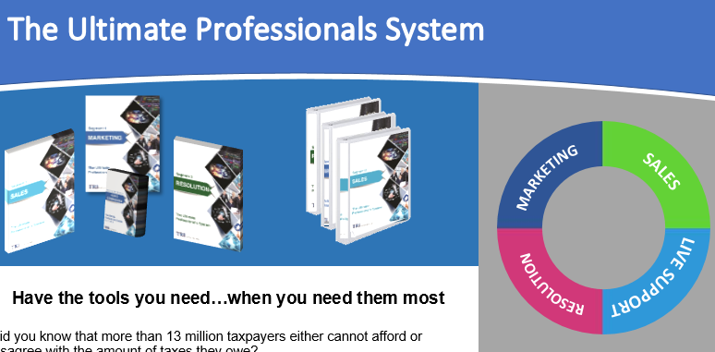
Drawing for free system (seminar attendee)
Charge up to 2 times your normal rate
Keep busy all year long
Solve even the most complex tax collection problems with our VIP ProgramTM
Find clients without spending too much time or too much money
Close a deal with little to no effort
$3,000.00

Slide 76
Why the TRI Ultimate Professional’s SystemTM?
GIVE AWAY KIT HERE TO SOMEONE IN THE ROOM…MAKE A BIG DEAL
Marketing
Sales
Live Support*
Resolution
* two months TRI VIP ProgramTM included

Slide 77
Morning Break
DAVID TO PUSH LINK
Morning Break
Sales & Marketing
75%off
$750
Only good until 6pm today
add the
Resolution Add-on Pack
for only $100 More
(a $500 value!)
Charge up to 2 times your normal rate
Keep busy all year long
Solve even the most complex tax collection problems with our VIP ProgramTM
Find clients without spending too much time or too much money
Close a deal with little to no effort
$3,000.00

Slide 78
Tax Resolution
Case Management from Start to Finish

Slide 79
Step 1: Meet with the client (by telephone or in person)
Identify and define issues
Discuss the process and expectations from the client
Estimate fees (lots more on this later today)
(800) 658-7590 www.taxresolutioninstitute.org

Slide 80
Step 2: Prepare Documents
Letter of Engagement (work agreement)
Power of Attorney Form/s
Payment Forms – ACH, credit card, PayPal
(800) 658-7590 www.taxresolutioninstitute.org

Slide 81
Step 3: Contact Government
Fax power of attorney (east or west coast CAF unit)
Call government representative (ACS or R/O)
Assess client’s (actual) situation
Request hold on collection (if applicable)
(800) 658-7590 www.taxresolutioninstitute.org

Slide 82
Step 4: Obtain or Prepare Tax Returns
Collect information
Prepare delinquent tax returns
Obtain duplicate original copies of all prepared tax returns
Calculate total estimated tax liability including penalties and interest
(800) 658-7590 www.taxresolutioninstitute.org

Slide 83
Step 5: Prepare Collection Information Statement
Obtain draft copy from client
Prepare 433A, 433F, 433B, etc.
If applicable contact the client to discuss options to lower Monthly Disposable Income (“MDI”)
(800) 658-7590 www.taxresolutioninstitute.org

Slide 84
Step 6: Negotiate with the Government
Have all paperwork (including IRS auto debit form i.e. 433D) prepared prior to call
Be ready to submit documents via fax if requested
If you are on the phone with Automated Collections (“ACS”), and it is not going well, end the call and try again
(800) 658-7590 www.taxresolutioninstitute.org

Slide 85
Step 7: Provide the client a comprehensive summary
Let the client know the agreed upon terms
Provide specific instructions relating to payment dates and amounts
Let the client know that if automated payments do not start when expected, they should make interim payments until the auto-pay kicks in
(800) 658-7590 www.taxresolutioninstitute.org

Slide 86
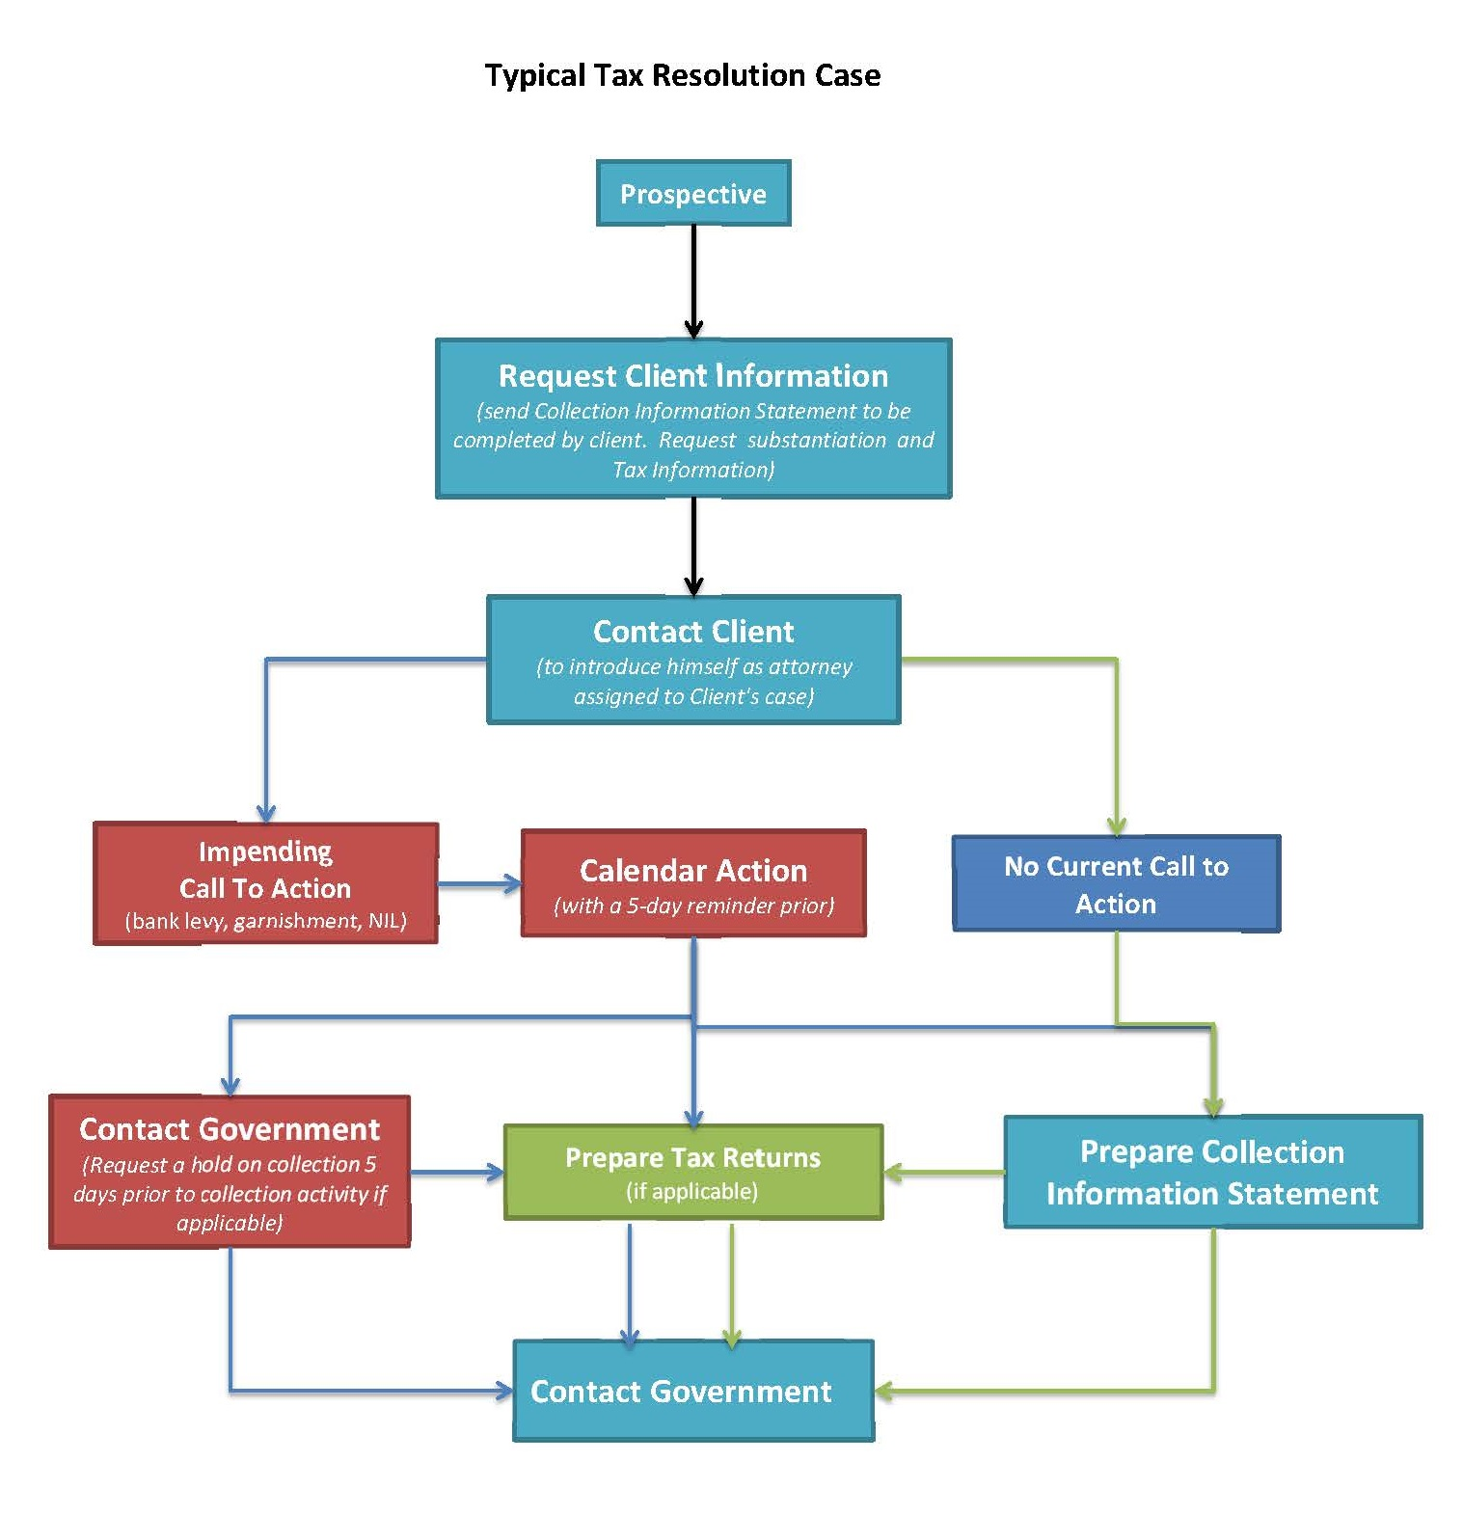
Sequence of
Events Flow
Chart

Slide 87
Don’t be pennywise and pound foolish!
Story Time
Salem story (pennywise pound foolish)
He followed an accountant from his firm to save a few thousand on fees
All deductions disallowed
$4,000,000 in assessment
It cost him six figures (in penalties interest and our fees)
(800) 658-7590 www.taxresolutioninstitute.org

Slide 88
Powers of Attorney

Slide 89
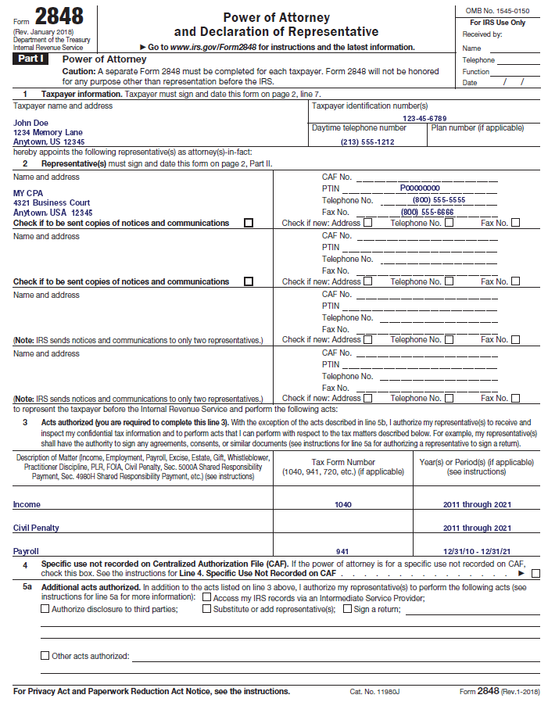
IRS Power of
Attorney
(page 1)

Slide 90
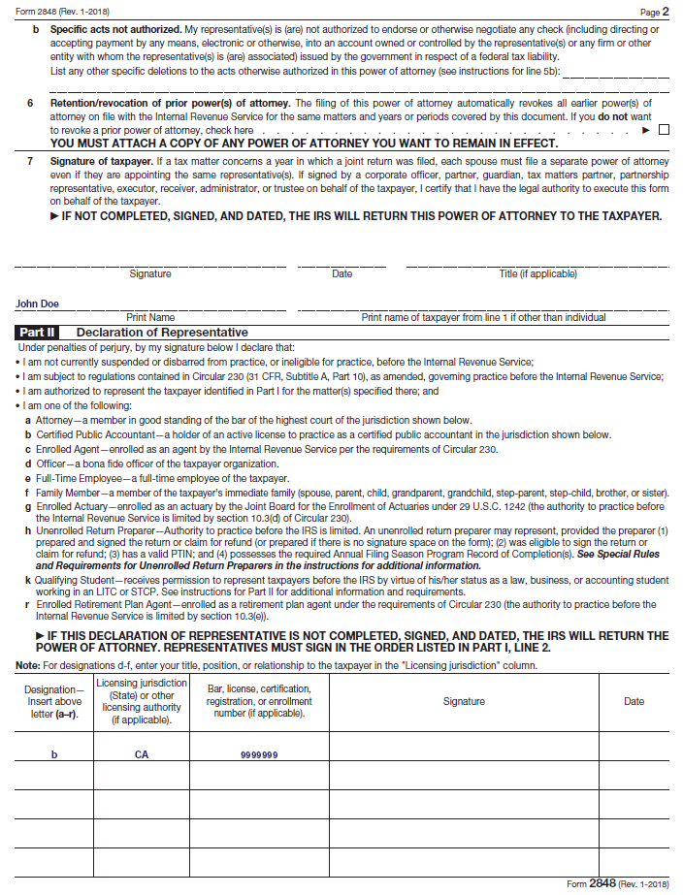
IRS Power of
Attorney
(page 2)

Slide 91
IRS Transcripts
Find us on the web at www.taxresolutioninstitute.org

Slide 92
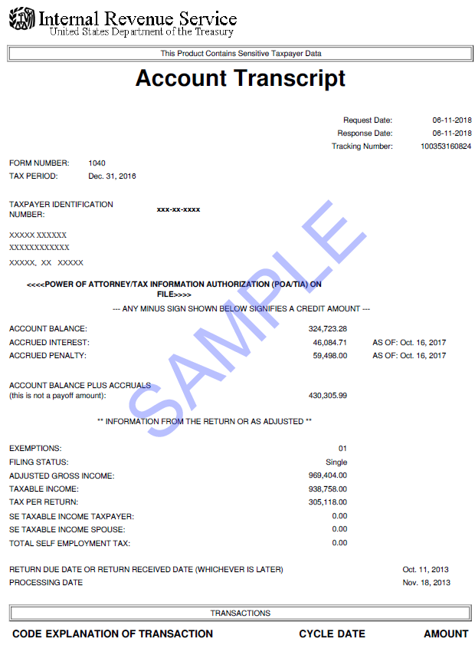
IRS Account Transcript (page 1)

Slide 93
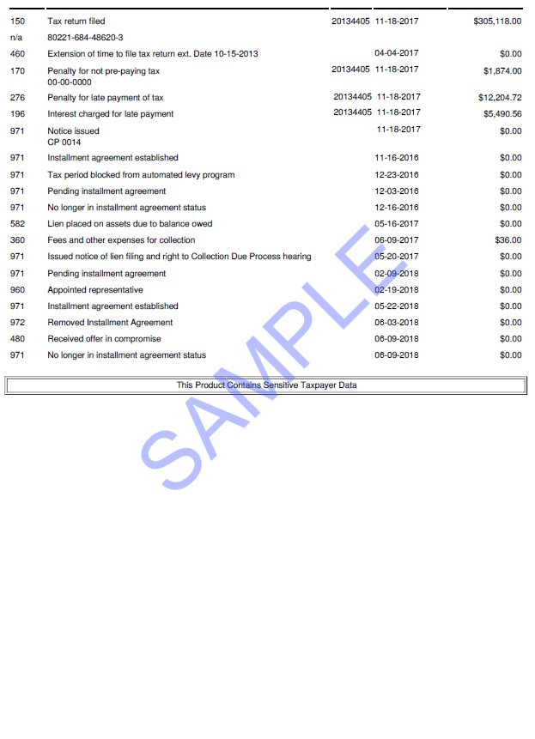
IRS Account Transcript (page 2)

Slide 94
Payroll Taxes
Find us on the web at www.taxresolutioninstitute.org

Slide 95
Payroll Taxes
“Borrowing” from the Government
Section 6672 of the tax code makes individuals personally liable
The withheld amounts constitute a “fund” one holds in “Trust” for the government.
(800) 658-7590 www.taxresolutioninstitute.org

Slide 96
Components of Payroll Taxes
Comprised of:
  Trust fund portion (employee withholdings including taxes, Social Security and Medicare)
  Non trust fund portion
  Interest (compounded daily)
  Penalties
Not Dischargeable in Bankruptcy
Trust Fund portion assessed personally to Responsible Person/s
(800) 658-7590 www.taxresolutioninstitute.org

Slide 97
A person will be held personally liable for the withheld taxes if…
They are responsible for its collection and payment
Their failure to collect the tax and pay it over is “willful”
(800) 658-7590 www.taxresolutioninstitute.org

Slide 98
Low Hanging Fruit #1
Represent your client in a Trust Fund Recovery Penalty 4180 interview
Earn $4,000 - $6,000 each

Slide 99
4180 Interview
What is a 4180 Interview?
This is the process the IRS uses to determine who is personally responsible for not making Federal payroll tax deposits.

Slide 100
4180 Interview
Acting timely with respect to assessing your client as the “Responsible Person” for the trust fund recovery penalty is of utmost importance.

Slide 101
4180 Interview
Things to consider…
Is your client an “owner” of the company?
Is your client a signer on the bank account?
Did your client sign paychecks?
Was your client the decision-maker with respect to non payment of payroll taxes?

Slide 102
4180 Interview
Preparation…
Obtain a copy of form 4180
Perform a mock interview – prepare your client
Prepare a collection information statement (433B if a business entity) to create an installment agreement at the interview?
Try and limit the number of responsible persons if you are representing more than one person?
Keep your client off the hook personally (at least for the short term…)

Slide 103
4180 Interview
Desired outcome…
Limit the number of responsible persons
Enter into an installment agreement for the company
Keep the responsible persons “off the hook” personally, at least for the time being

Slide 104
Low Hanging Fruit #2
    Status 63
    keep your client off the hook personally
    Earn $1,000/hr

Slide 105
Status 63
We cannot stress this enough…your expertise should dictate the fees you charge, not the time you spend…
Entering your client into Status 63 will save them in ways you cannot imagine

Slide 106
Status 63
What is IRS Status 63?
If a business remains in good standing subsequent to entering into an installment agreement, the IRS may delay/forego assessing and collecting from responsible person/s.

Slide 107
Status 63
Things to consider…
Is the business able to maintain installment agreement payments?
Will the business stay current on tax filings?
Can the business make estimated payments going forward?
Are the responsible persons in compliance on a personal level?

Slide 108
Status 63
Benefits
The entity/owners only need to make a single monthly payment
The responsible person/s need not pay personally
The responsible person/s credit is not affected

Slide 109
Get Grandma off the hook…
Story Time
Payroll taxes/trust fund assessment
Teresa (realtor) construction company with daughters on the hook
Tell story about grandma getting assessed and IRS reaching for other people to be personally liable/accountant bookkeeper bank signatories
(800) 658-7590 www.taxresolutioninstitute.org

Slide 110
Installment Agreements

Slide 111
Installment Agreement
A payment plan between taxpayer and the Government
Some agreements require the full payment of the tax liability
Other agreements allow the taxpayer to partially pay their liability in monthly installments based upon their ability (or inability) to pay over time
Taxpayer must be in and remain in compliance
IRS has ten-year statute of limitations on “active” collection
(800) 658-7590 www.taxresolutioninstitute.org

Slide 112
Streamlined Installment Agreement
Taxpayer is in compliance and able to full-pay their liability over time (up to 72 months)
Taxpayer owes less than $25,000
Taxpayer owes less than $50,000
Representation fees are lower but installment payments are typically higher
If client is “uncollectable” this type of agreement will not work
(800) 658-7590 www.taxresolutioninstitute.org

Slide 113
Streamlined Installment Agreements
Maximum amount increased from $50,000 to $100,000
Payment term increased from 72 months to 84 months
No substantiation required
Must be paid by direct debit or deducted from paycheck
A lien may or may not be filed
(800) 658-7590 www.taxresolutioninstitute.org

Slide 114
Installment Agreement Forms
433A
  Collection information statement for individuals (Revenue Officer)
433F
  Abridged collection information statement for individuals (automated collections)
433B
  Collection information statement for businesses
9465/FS
  Installment agreement request form
(800) 658-7590 www.taxresolutioninstitute.org

Slide 115
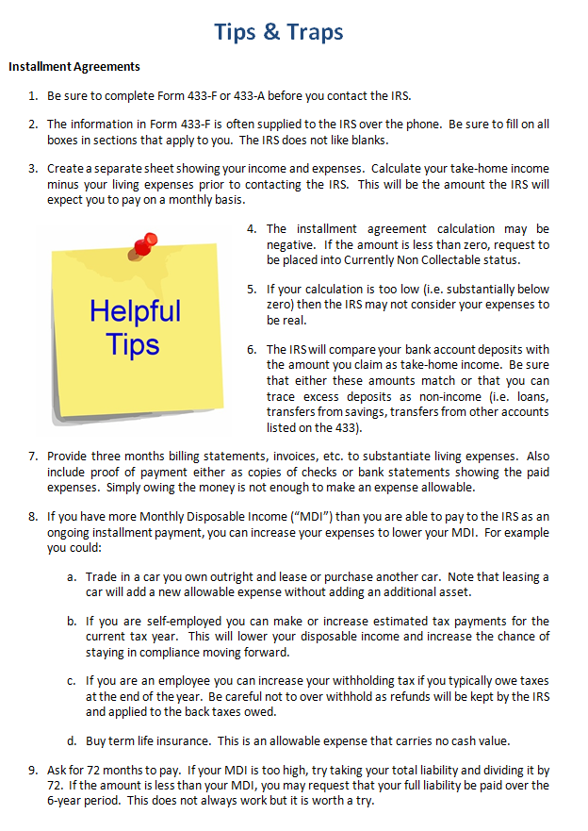
Installment Agreements
Find these tips and other valuable materials on the web at www.taxresolutioninstitute.org/200A
tab or by emailing us at info@taxresolutioninstitute.com

Slide 116
Low Hanging Fruit #3
Streamlined Installment Agreements
Earn $1,000 - $2,500 each

Slide 117
IRS Streamlined Installment Agreements
Your expertise should dictate the fees you charge, not the time you spend…
A streamlined installment agreement requires more than just making a call…

Slide 118
IRS Streamlined Installment Agreements
Things to consider…
Does the client owe $25,000 or less?
Does the client owe $50,000 or less?
Does the client owe $100,000 or less?
Did you advise the client to pay down their liability if they owe more?
Is the client in current compliance?
Have recent tax filings posted?

Slide 119
IRS Streamlined Installment Agreements
Preparation…
Do you have your client’s bank information (account and routing number)?
Did you predetermine a day of the month to debit your client’s account?
Have you completed IRS form 9465?
Have you completed form 433D?

Slide 120
IRS Streamlined Installment Agreements
Complete the task in one call…
Do your homework before you make the call…pull transcripts to verify information
Make sure you have time to wait on hold
Have all forms completed prior to the call
Get client signatures as necessary

Slide 121
IRS Streamlined Installment Agreements
Summary
Streamlined installment agreements seem simple but if you are not prepared, you can easily spend extra time completing the task
If you are prepared and get things done efficiently, you should be compensated for your knowledge

Slide 122
Tax Tax and More Tax
Why are we here today?
The Tax Resolution Institute prides itself in assisting accounting, legal and other professionals resolve their client’s tax problems and grow their businesses
Take advantage of one of our many programs
We help you make more money
We teach you how to become a tax resolution specialist
We become your partner working side-by-side to fix your client’s IRS and State income, payroll (collection issues) and tax audit issues
Or…we become your trusted referral source
(800) 658-7590 www.taxresolutioninstitute.org

Slide 123
Case Study
Installment Agreement

Slide 124
Case Study (CS-2)
Installment Agreement
Family of 4
Living in Los Angeles
Husband is a self-employed salesperson (expects to earn substantially more income in the near future)
Wife works and is a W-2 wage earner
Taxes are withheld from Wife’s paycheck and Husband is making estimated tax payments.
Wife owns a vehicle with a small amount of equity
Husband leases another vehicle
They own a single family home with some equity
Wife has an IRA with a relatively low value ($12,858)
They owe approximately $487,000 in unpaid taxes.
access your free content at www.taxresolutioninstitute.org

Slide 125
Installment Agreement - Family of Four (Case Study 1)
 | Item |  |  |  | Monthly Amount
Income
 | Gross Wages |  | Taxpayer |  | 8,662
 |  |  | Spouse |  | 5,576
 |  |  | Total: |  |  | 14,238
Expenses
 | Housing and Utilities
 |  | Mortgage |  |  | 3,079
 |  | Utilities |  |  | 256
 | Food/Clothing/Etc |  |  |  | 1,694
 | Transportation | Payments |  |  | 970
 |  | Maintenance/gas/insurance |  |  | 994
 | Medical | Health insurance |  |  | 674
 |  | Out-of-pocket health care |  |  | 208
 | Taxes |  |  |  | 5,790
 | Other | Childcare |  |  | 219
 |  | Life insurance |  |  | 135
 |  | Living expenses: |  |  |  | 14,019
 |  | Proposed installment amount: |  |  |  | 219
Installment
Agreement
Analysis

Slide 126
Installment Agreement
Success Stories

Slide 127

IRS Installment Agreement

Slide 128

IRS Partial Pay Installment Agreement

Slide 129

California FTB Installment Agreement

Slide 130
IRS National & Local Standards

Slide 131
Food, Clothing and Other Items
Expense | 1 Person | 2 Persons | 3 Persons | 4 Persons
Food | $334 | $646 | $742 | $888
Housekeeping supplies | $35 | $64 | $63 | $75
Apparel & services | $89 | $142 | $185 | $264
Personal care products & services | $38 | $69 | $71 | $75
Miscellaneous | $151 | $281 | $323 | $392
Total | $647 | $1,202 | $1,384 | $1,694
More than 4 persons | Additional Persons Amount
For each additional person, add to four-person total allowance: | $357

Slide 132
Housing and Utilities
 | Housing and Utilities for a Family of 1 | Housing and Utilities for a Family of 2 | Housing and Utilities for a Family of 3 | Housing and Utilities for a Family of 4 | Housing and Utilities for a Family of 5 or more
Kings County | 1,441 | 1,693 | 1,784 | 1,989 | 2,021
Lake County | 1,499 | 1,760 | 1,855 | 2,068 | 2,102
Lassen County | 1,471 | 1,728 | 1,821 | 2,030 | 2,063
Los Angeles County | 2,199 | 2,583 | 2,722 | 3,035 | 3,084
Madera County | 1,478 | 1,736 | 1,829 | 2,039 | 2,072
Marin County | 3,067 | 3,602 | 3,796 | 4,233 | 4,301

Slide 133
Transportation
Public Transportation
National | $178
Ownership Costs
 | 1 Car | 2 Cars
National | $497 | $994
Operating Costs
 | 1 Car | 2 Cars
West Region | $218 | $436
Los Angeles | $289 | $578
Phoenix | $220 | $440
San Diego | $261 | $522
San Francisco | $235 | $470
Seattle | $216 | $432

Slide 134
Out-of-Pocket Health Care
Ownership Costs | Out of Pocket costs
Under 65 | $52
65 and Older | $114

Slide 135
Offers in Compromise
Find us on the web at www.taxresolutioninstitute.org

Slide 136
Offer in Compromise
Submitting an Offer in Compromise is the process in which a taxpayer requests to reduce their Internal Revenue Service or State tax debt by negotiating for an amount less than the actual amount they owe…
access your free content at www.taxresolutioninstitute.org

Slide 137
The IRS has the authority to settle or “compromise” tax liability by accepting less than full payment under certain circumstances
A Federal tax debt may be legally compromised under one of the three following conditions…
access your free content at www.taxresolutioninstitute.org

Slide 138
Three types of offers…
access your free content at www.taxresolutioninstitute.org/200a

Slide 139
Doubt as to Collectability
Taxpayer is unable to pay their tax liability (accounting for income and assets) within the statute of limitations on collection
Doubt as to Liability
The taxpayer is not responsible for paying the tax liability in question and should not have been assessed
Effective Tax Administration
The taxpayer owes the tax, has the ability to pay (i.e. equity in their home) but collecting from the taxpayer would be unjust
access your free content at www.taxresolutioninstitute.org

Slide 140
Doubt as to Collectability
access your free content at www.taxresolutioninstitute.org/200a

Slide 141
Doubt as to Collectability
When and how should you submit an offer?
Things to consider
How much does the taxpayer owe (cost vs benefit)?
How much time is left on the collection statute?
What events toll the collection statue
What is the value of the taxpayer’s assets
Did the taxpayer dissipate assets when taxes were owed?

Slide 142
Doubt as to Collectability
When and how should you submit an offer?
Things to consider
Compare what a taxpayer would pay in monthly installment payments vs a lump sum offer
Will the taxpayer be able to remain in compliance for 5 years following acceptance of the offer
Is the taxpayer’s income expected to change significantly during the collection statute?
Are the taxes more than 3 years old?

Slide 143
Doubt as to Collectability
How much does the taxpayer owe?
Does the work warrant your fees?
A properly prepared offer should take no more than 15 hours to complete assuming client is cooperative and offer gets accepted in 1st round
An offer can exceed $20,000 in fees if in addition there is a State offer, the client is uncooperative or the offer must be appealed
access your free content at www.taxresolutioninstitute.org/200a

Slide 144
Doubt as to Collectability
How much time is left on the collection statute?
The IRS has 10 years from the date of assessment to actively collect against a taxpayer
The following events toll (freeze) the statute for collection:
Prior submission of an offer in compromise
Prior bankruptcy filing
CAP/CDP request
Living outside the US for an extended period of time
access your free content at www.taxresolutioninstitute.org/200a

Slide 145
Doubt as to Collectability
How much time is left on the collection statute?
If a taxpayer does not have substantial equity in real property for which a Federal tax lien can attach, it may make sense to submit a partial-pay installment agreement in lieu of an offer if the remaining life in the statute is short enough
The collection statute should be considered for other alternatives including filing bankruptcy
access your free content at www.taxresolutioninstitute.org/200a

Slide 146
Doubt as to Collectability
What is the value of the taxpayer’s assets?
It is imperative to weigh the value of assets as well as to consider the amount the taxpayer will pay in monthly disposable income when considering whether to submit an offer rather than an installment agreement
If the taxpayer has assets with substantial value, they may be forced to liquidate at least some of their assets to pay for the offer
The IRS may ignore the value of some assets when negotiating an installment agreement. This is not the case with an offer.

Slide 147
Doubt as to Collectability
Did the taxpayer dissipate assets when taxes were owed?
It is important to ask this question to your client.
In many instances the IRS asserts that the taxpayer dissipated assets
Some examples of the dissipation of assets include:
Taking money from a refinance of real estate
Cashing out an investment or retirement account
Gifting proceeds when taxes are due
Selling assets such as a boat or motorhome and spending the proceeds
access your free content at www.taxresolutioninstitute.org/200a

Slide 148
Doubt as to Collectability
Compare what a taxpayer would pay in monthly installment payments vs a lump sum offer
As part of considering the remaining life of the collection statute, compare how much a taxpayer will pay in aggregate installment payments compared to a lump sum offer
If a taxpayer has real property with equity, the IRS will remove the lien if the client’s offer is accepted
Be careful when recommending an installment agreement as a lien may remain in effect after the installment agreement is complete
access your free content at www.taxresolutioninstitute.org/200a

Slide 149
Doubt as to Collectability
Will the taxpayer be able to remain in compliance for 5 years following acceptance of the offer?
Can the taxpayer afford your fees?
Can the taxpayer afford the cost of the offer?
Will the taxpayer be diligent in the preparation of his or her tax returns for 5 years from the date of acceptance?
Will the taxpayer be diligent in paying his or her liability including making estimated tax payments for 5 years from the date of acceptance?
If client cannot remain in compliance the offer will be cancelled and all compromised liability will be reassessed including all interest and penalties
access your free content at www.taxresolutioninstitute.org/200a

Slide 150
Don’t be the “nice guy”…
Story Time
OIC: “Laura” – Owed $270,000
Outcome
Settled for $3,501
TRI fronted down payment
Client defaulted on offer amount
$270,000 liability with penalties and interest reinstated
Moral
Get your fees up front
Don’t feel sorry for the client
Don’t be a nice guy & advance the 20% down payment
(800) 658-7590 www.taxresolutioninstitute.org

Slide 151
Doubt as to Collectability
Is the taxpayer’s income expected to change significantly during the collection statute?
If the taxpayer expects their income to go down significantly, it may be worth planning and postponing submission of an offer or doing a PPIA
If the taxpayer expects their income to go up significantly in the 12 months subsequent to submission of an offer, as the IRS may ask for updated financials that may negatively affect acceptance of the offer
An increase in income may be overcome by negotiating a collateral agreement in conjunction with the offer
access your free content at www.taxresolutioninstitute.org/200a

Slide 152
Doubt as to Collectability
Are the taxes more than 3 years old?
Prior to deciding whether an offer should be prepared, consider and discuss with your client discharging the taxes in bankruptcy
If you expect that the taxes are dischargeable, have a qualified person prepare a tax dischargeability analysis (“TDA”). The 3-year rule, the 2-year rule and the 240-day rule. This is covered in the 200A course.
One size does not fit all. Know all your options so you can best serve your client.
access your free content at www.taxresolutioninstitute.org/200a

Slide 153
Doubt as to Liability
access your free content at www.taxresolutioninstitute.org/200a

Slide 154
Doubt as to Liability
When and how should you submit an offer?
Things to consider
Taxpayer assessed for liability they do not owe?
Does the taxpayer have substantiation to support their claim?
Can you reduce the liability enough to spend the time and money necessary to complete the offer?
Did the assessment in question arise from a tax audit?
Was a tax court petition filed?

Slide 155
Doubt as to Liability
Taxpayer assessed for liability they do not owe?
This may seem like a simple question but keep in mind it needs to be answered by a tax professional, not the taxpayer (they never think they owe it).
Do some due diligence to determine (1) why the tax was assessed and (2) what has been done to contest the assessment
Make sure the client has reasonable expectations (ha ha…)
access your free content at www.taxresolutioninstitute.org/200a

Slide 156
Doubt as to Liability
Does the taxpayer have substantiation to support their claim?
Assuming your client has a case…now comes the real work
Was the client assessed because the IRS was being unreasonable or because their representative “didn’t show up” for the audit?
Does your client have adequate documentation to substantiate their claim?
Essentially this is an audit reconsideration
Do not do this work on a fixed fee basis
access your free content at www.taxresolutioninstitute.org/200a

Slide 157
Doubt as to Liability
Can you reduce the liability enough to spend the time and money necessary to complete the offer in compromise?
If your client has a case and they have the substantiation to support it, will the cost to defend them outweigh the benefits?
This should be considered relative to the overall cost of your time (prize vs price)
This should also be considered if a substantially high liability will remain even if an offer is accepted
access your free content at www.taxresolutioninstitute.org/200a

Slide 158
Doubt as to Liability
Did the assessment in question arise from a tax audit?
This type of offer (doubt as to liability) gives the taxpayer a 2nd bite at the apple.
We have been successful in converting audits in which all deductions were disallowed to assessments producing little to no tax
The IRS seems to be more reasonable in considering taxpayer substantiation at this level
access your free content at www.taxresolutioninstitute.org/200a

Slide 159
Doubt as to Liability
Was the assessment appealed and a what level?
Was a tax court petition filed?
You cannot submit an offer in compromise doubt as to liability if a tax court petition has been filed
access your free content at www.taxresolutioninstitute.org/200a

Slide 160
Can you be in two places at once?
Story Time
OIC: Cerasale Story
Lived in San Francisco
Had business in Florida
Remind about “grandma story”
(800) 658-7590 www.taxresolutioninstitute.org

Slide 161
Effective Tax Administration
access your free content at www.taxresolutioninstitute.org/200a

Slide 162
Effective Tax Administration
The taxpayer owes the tax, has the ability to pay (i.e. equity in their home) but collecting from the taxpayer would be unjust
access your free content at www.taxresolutioninstitute.org/200a

Slide 163
Effective Tax Administration
A determination of doubt as to collectability will include a determination of ability to pay. The determination of the amount of such basic living expenses will be founded upon an evaluation of the individual facts and circumstances presented by the taxpayer submitting a collection information statement (Form 433A OIC)
To formulate this determination, guidelines published on National and Local living expense standards are taken into account
access your free content at www.taxresolutioninstitute.org

Slide 164
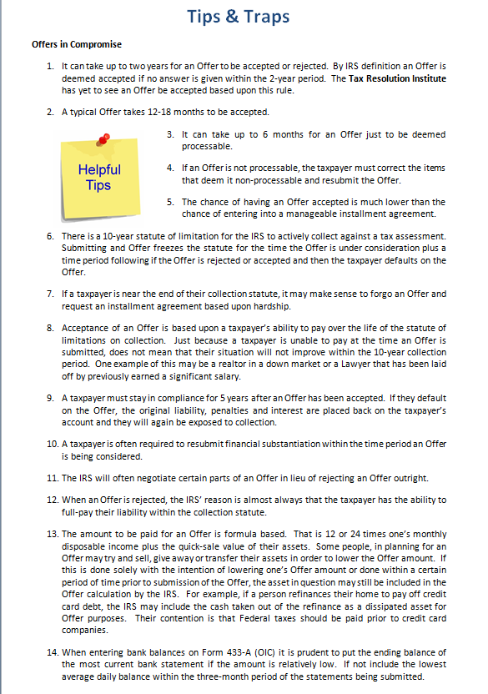
Offers in Compromise
Find these tips and other valuable materials on the web at www.taxresolutioninstitute.org/200A
tab or by emailing us at info@taxresolutioninstitute.com

Slide 165
TRI
Tax Resolution Institute
SST CPAS INC
Certified Public Accountants
Offer in Compromise
Success Stories…

Slide 166

IRS Offer in Compromise

Slide 167

IRS Offer in Compromise

Slide 168

IRS Offer in Compromise

Slide 169

IRS Offer in Compromise

Slide 170

IRS Offer accepted…
and then rejected
for nonpayment

Slide 171

California FTB Offer in Compromise

Slide 172

CDTFA (sales tax) Offer in Compromise

Slide 173

New York DTF Offer in Compromise

Slide 174
Marketing & Selling
Professional Services

Slide 175
Sales
TRI
For Service Professionals

Slide 176
I’m a service professional, why do I need help selling?
Everyone sells themselves in one way or another
Rainmakers and other professionals waste way too much time selling to unqualified prospects
If you sell properly, you will increase firm revenue and become a hero

Slide 177
Why is the TRI Ultimate Professional’s SystemTM right for you?
Easy to use
Provides immediate results
Allows you to invest a minimum amount of time and money

Slide 178
again…
YOU NEED A SYSTEM
(if you can measure it…you can control it)

Slide 179
The TRI “Ultimate Professional’s SystemTM was born from TRI’s Marketing Success
Increase in close rates year-over-year for 7 years running
Reduction of average time selling from 54 minutes to 22 minutes per prospect (including closed sales)
Sales staff morale is up substantially
Revenue has increased by 23.8% on an average annual basis

Slide 180

Your Success Using the TRI Ultimate Professional's SystemTM gets you…
More Clients
Higher fees/revenue
Steady stream of business
More time billing…less time selling
100% MONEYBACK GUARANTEE

Slide 181
Work smarter…not harder
(800) 658-7590 www.taxresolutioninstitute.org

Slide 182
Drawing for free system (webcast attendee)
Charge up to 2 times your normal rate
Keep busy all year long
Solve even the most complex tax collection problems with our VIP ProgramTM
Find clients without spending too much time or too much money
Close a deal with little to no effort
$3,000.00

Slide 183
Why the TRI Ultimate Professional’s SystemTM?
GIVE AWAY KIT HERE TO SOMEONE ONLINE (WEBCAST)…MAKE A BIG DEAL
Marketing
Sales
Live Support*
Resolution
* two months TRI VIP ProgramTM included

Slide 184
Lunch Break
DAVID TO PUSH LINK
Morning Break
Sales & Marketing
75%off
$750
Only good until 6pm today
add the
Resolution Add-on Pack
for only $100 More
(a $500 value!)
Charge up to 2 times your normal rate
Keep busy all year long
Solve even the most complex tax collection problems with our VIP ProgramTM
Find clients without spending too much time or too much money
Close a deal with little to no effort
$3,000.00

Slide 185
Crossing the River

Slide 186
Tax Tax and More Tax
Why are we here today?
The Tax Resolution Institute prides itself in assisting accounting, legal and other professionals resolve their client’s tax problems and grow their businesses
Take advantage of one of our many programs
We help you make more money
We teach you how to become a tax resolution specialist
We become your partner working side-by-side to fix your client’s IRS and State income, payroll (collection issues) and tax audit issues
Or…we become your trusted referral source
(800) 658-7590 www.taxresolutioninstitute.org

Slide 187
You can’t cross the river alone
Morning Break
Sales & Marketing
75%off
$750
Only good until 6pm today
add the
Resolution Add-on Pack
for only $100 More
(a $500 value!)
DAVID TO PUSH LINK
Charge up to 2 times your normal rate
Keep busy all year long
Solve even the most complex tax collection problems with our VIP ProgramTM
Find clients without spending too much time or too much money
Close a deal with little to no effort
$3,000.00

Slide 188
Again..
Why you need to market, sell and practice tax resolution
Regular tax returns are a commodity. You make between $400 and $1,000 for normal return
Each resolution case runs from $4000 – $10,000 (ten times the amount for tax returns)
Using a system, this work is easy and manageable
Setting up shop yields immediate results

Slide 189
Case Study
(revisited)
Offer in Compromise
Find us on the web at www.taxresolutioninstitute.org

Slide 190
Case Study (CS-2)
Offer in Compromise
Family of 4
Living in Los Angeles
Husband is a self-employed salesperson (expects to earn substantially more income in the near future)
Wife works and is a W-2 wage earner
Taxes are withheld from Wife’s paycheck and Husband is making estimated tax payments.
Wife owns a vehicle with a small amount of equity
Husband leases another vehicle
They own a single family home with some equity
Wife has an IRA with a relatively low value ($12,858)
They owe approximately $487,000 in unpaid taxes.
access your free content at www.taxresolutioninstitute.org

Slide 191
Offer in Compromise
vs
Installment Agreement
(comparison)
Find us on the web at www.taxresolutioninstitute.org

Slide 192
Installment Agreement and Offer in Compromise Comparison - Family of Four
Item |  |  | IA |  | OIC |  |  | Notes
Income
Wages | Taxpayer |  | 8,662 |  | 8,662 |  |  | Actual
 | Spouse |  | 5,576 |  | 5,576 |  |  | Actual
 | Total: |  |  | 14,238 |  | 14,238
Expenses
 | Mortgage |  | 3,079 |  |  |  |  | Actual for IA
 | Utilities |  | 256 |  |  |  |  | Actual for IA
 |  |  |  | 3,335 |  | 3,035 |  | OIC amount is based upon IRS local std.
 | Food/Clothing/Etc. |  |  | 1,694 |  | 1,694 |  | IRS national standard
 | Car payments |  |  | 970 |  | 970 |  | Actual
 | Maint./gas/ins |  |  | 994 |  | 994 |  | IRS local standard
 | Health insurance |  |  | 674 |  | 674 |  | Actual
 | Out-of-pocket health |  |  | 208 |  | 208 |  | IRS national standard
 | Taxes |  |  | 5,790 |  | 5,790 |  | Actual
 | Childcare |  |  | 219 |  | 219 |  | Actual
 | Life insurance |  |  | 135 |  | 135 |  | Actual
 | Total living expenses: |  |  | 14,019 |  | 13,719
Monthly Disposable Income: |  |  |  | 219 |  | 519
OIC vs IA
Comparison

Slide 193
should they do an
Offer or
Installment Agreement?
…let’s see
193
(800) 658-7590 www.taxresolutioninstitute.org

Slide 194
OIC vs Installment Agreement
Installment Agreement
Monthly payment amount - $219
Number of months to pay - 120 (assuming full 10-year statute remains)
219 x 120 = $26,280 (this number is subject to increase…IRS revisits installment agreements every 2 years)
Offer in Compromise
Offer amount (based on $519 in MDI) - $15,051*
*Paid as follows - 20% down and the balance paid within 5 months after offer is accepted (typically 18 to 24 months after offer is submitted).
Assuming the Does estimate they will earn substantially more money in the near future, an Offer in Compromise would far outweigh an Installment Agreement.

Slide 195
IRS Criminal Investigation (“CI”)

Slide 196
Overview
Headquartered in Washington DC
Approximately 2,600 special agents
When individuals and corporations make deliberate decisions to not comply with the law, they face the possibility of a civil audit or criminal investigation
Agents use specialized forensic technology to recover financial data
Conviction rate is one of the highest in federal law enforcement
(800) 658-7590 www.taxresolutioninstitute.org

Slide 197
History
Created July 1, 1919
Called to probe in assertions of tax fraud
Was originally composed of a small group of postal inspectors
Became known nationwide when they assisted in the conviction of Al Capone for income tax evasion
Changed its name to Criminal Investigation (“CI”) in 1978
Primary objective is to ensure the integrity and fairness of the United States tax system
(800) 658-7590 www.taxresolutioninstitute.org

Slide 198
CI’s Main Concerns
Tax evasion
Filing a false return
Failure to file a tax return
(800) 658-7590 www.taxresolutioninstitute.org

Slide 199
Year-over-Year Comparison (2014 – 2016)
 | FY 2016 | FY 2015 | FY 2014
Investigations Initiated | 3,395 | 3,853 | 4,297
Prosecution Recommendations | 2,744 | 3,289 | 3,478
Indictments/Information's | 2,761 | 3,208 | 3,272
Convictions | 2,672 | 2,879 | 3,110
Sentenced* | 2,699 | 3,092 | 3,268
Percent to Prison | 79.9% | 80.8% | 79.6%
* Incarceration includes confinement to federal prison, halfway house, home detention, or some combination thereof. Data Source: Criminal Investigation Management Information System
IRS CI
Statistics

Slide 200
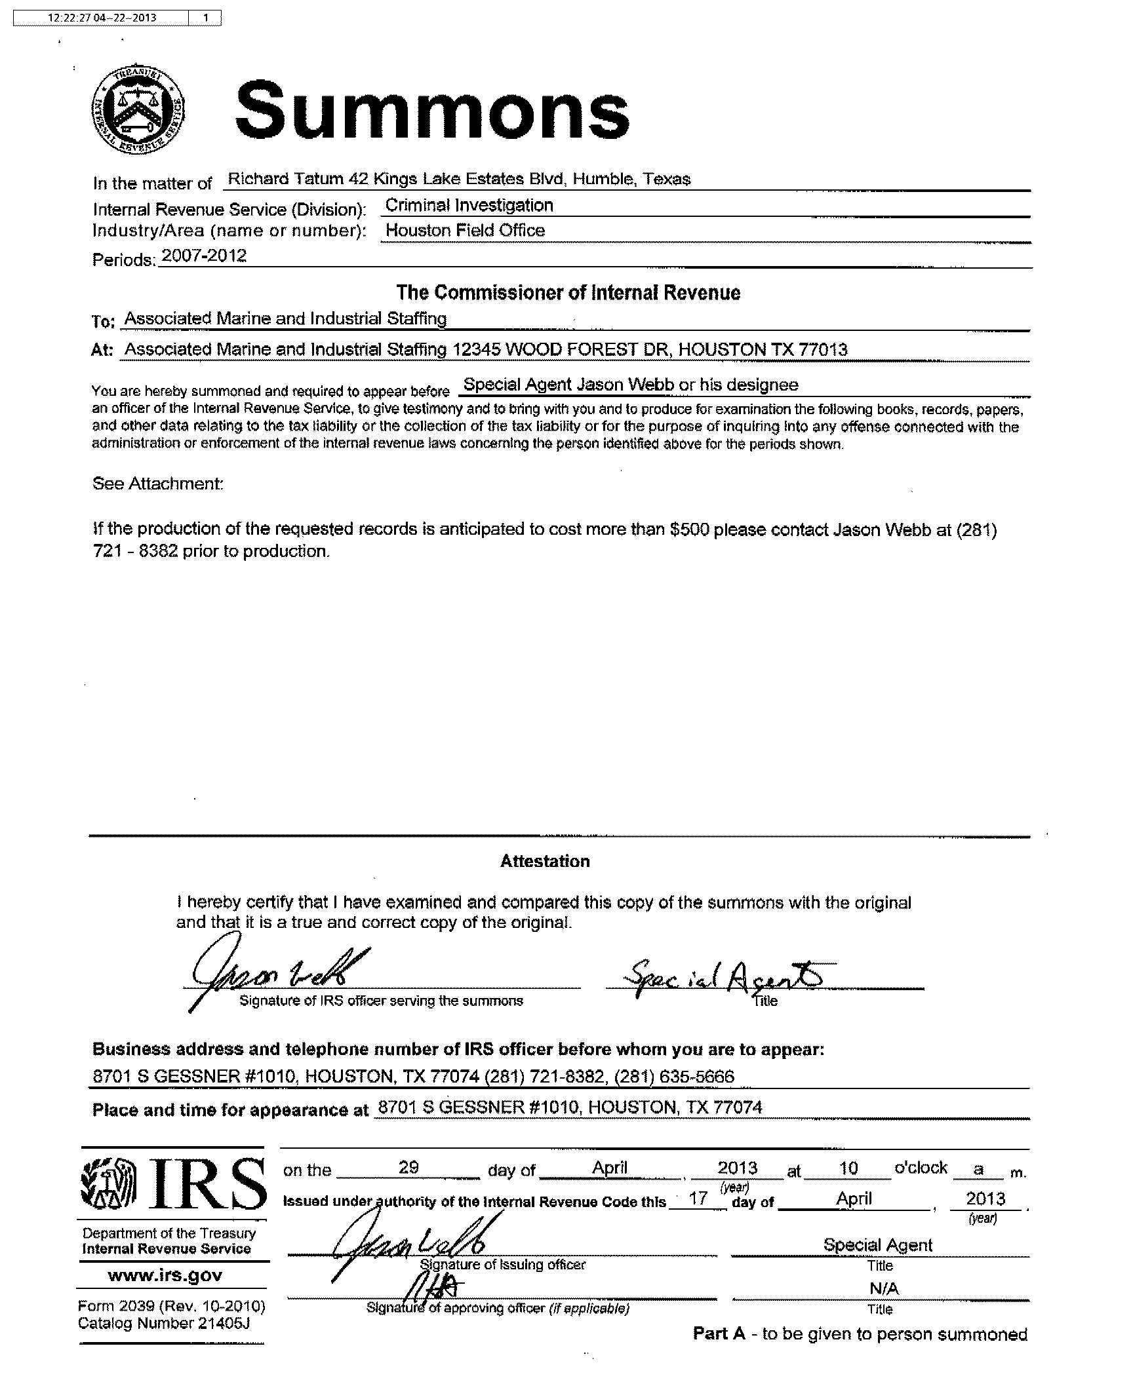
Sample
IRS Summons

Slide 201
Interesting CI Fact
…they tell me that the CI threshold for understatement of tax is $30,000
(800) 658-7590 www.taxresolutioninstitute.org

Slide 202
Tax Tax and More Tax
Why are we here today?
The Tax Resolution Institute prides itself in assisting accounting, legal and other professionals resolve their client’s tax problems and grow their businesses
Take advantage of one of our many programs
We help you make more money
We teach you how to become a tax resolution specialist
We become your partner working side-by-side to fix your client’s IRS and State income, payroll (collection issues) and tax audit issues
Or…we become your trusted referral source
(800) 658-7590 www.taxresolutioninstitute.org

Slide 203
Get your tax resolution questions
answered for free!
TRI is proud to offer…as part of Tax Tuesdays™ the
Monthly Tax Resolution
Practitioner’s Forum
Join us on the 1st Tuesday of each month…
203

Slide 204
Innocent Spouse Relief

Slide 205
New rules created in September of 2013 under Rev. Proc. 2013-34 relax rules that are deemed necessary to qualify for relief.
(800) 658-7590 www.taxresolutioninstitute.org

Slide 206
Three Types of Innocent Spouse Relief
Traditional Relief – IRC Section 6015(b)
Spousal Allocation – IRC Section 6015(c)
Equitable Relief – IRC Section 6015(f)
The “Old” Way..
(800) 658-7590 www.taxresolutioninstitute.org

Slide 207
Definitions of the three types
(800) 658-7590 www.taxresolutioninstitute.org

Slide 208
Type 1 - Traditional Spouse Relief – 6015(b)
The standards set to receive relief under this method are difficult to meet
Spouse seeking relief must show he or she was unware (and had no way of knowing) that income was under-reported
This type of relief is not available if original liability assessed was not paid (allowed in deficiency cases, not allowed if payment was never made)
Important to remember!
(800) 658-7590 www.taxresolutioninstitute.org

Slide 209
Type 2 - Spousal Allocation – 6015(c)
Spouse seeking relief allocates additional tax assessed proportionate to involvement in the income being under-reported
Community property laws are disregarded in this case
Person seeking this relief must be legally separated or no longer married
(800) 658-7590 www.taxresolutioninstitute.org

Slide 210
Type 2 - Spousal Allocation – 6015(c) …continued
The burden of proof is on the IRS to show that the person seeking relief had actual knowledge (not reason to know) that income was under-reported at the time the tax return was signed
No refunds are permitted under this election
No refunds!
(800) 658-7590 www.taxresolutioninstitute.org

Slide 211
Type 3 Equitable Relief– 6015(f)
Only used if relief is not allowed under Traditional Spouse Relief [6015(b)] and Spousal Allocation [6015(c)]
Amount of relief is subject to unpaid balance shown on tax return
Refunds are permitted under this election
Refunds allowed!
(800) 658-7590 www.taxresolutioninstitute.org

Slide 212
What these have in common…
A joint tax return exists
Relief applies only to tax on income (excludes FBAR, Civil Penalty, etc.)
Spouse seeking relief filed IRS Form 8857 timely
  Within 2 years of collection activity for 6015 (b) & 6015 (c)
  Within collection statute for 6015(f) (typically 10 years)
(800) 658-7590 www.taxresolutioninstitute.org

Slide 213
Rev Proc 2013-34
Requesting spouse must satisfy all of the following conditions to qualify for equitable relief:
A joint tax return was filed
Requestor cannot obtain relief under Traditional Spouse Relief [6015(b)] and Spousal Allocation [6015(c)]
Request must be made timely
No fraudulent transfer of assets occurred between spouses
A return unsigned by one spouse still may be considered jointly filed
(800) 658-7590 www.taxresolutioninstitute.org

Slide 214
Rev Proc 2013-34
Conditions continued:
Non-requesting spouse did not transfer disqualified assets to requesting spouse
(this not an issue if requesting spouse was subject to abuse, the non-requesting spouse had restricted access to financial information or was unaware of the transfer in question)
Requesting spouse did not knowingly participate in the filing of a fraudulent return
Income tax liability for which the requesting spouse is seeking relief can be attributed (in part or full) to an event directly tied to the non-requesting spouse or an underpayment attributable to the non-requesting spouse’s income
(800) 658-7590 www.taxresolutioninstitute.org

Slide 215
Innocent Spouse Streamlined Determinations
If the aforementioned conditions are met, the IRS may grant equitable relief if the requestor:
Is no longer married to the non-requesting spouse
Would suffer financial hardship if relief is not granted
Did not have knowledge or reason to have knowledge of any understatement or deficiency on the return in question
Did not know that the non-requesting spouse could not or would not pay the full liability reflected on the return
Does not need to be met in cases of abuse or lack of financial control
(800) 658-7590 www.taxresolutioninstitute.org

Slide 216
Innocent Spouse Non-Streamlined Determinations
Marital Status
Economic Hardship
Knowledge
Abuse
Legal Obligation
Significant benefit
Compliance with income tax laws
Mental health
Physical health
(800) 658-7590 www.taxresolutioninstitute.org

Slide 217
Innocent Spouse Non-Streamlined Determination Factors
Factors
No factor is controlling
Factors are classified as “favorable”, “unfavorable” or neutral
Marital Status – spouses are legally separated, divorced, widowed or in separate households for a 12-month period ending on the date of determination (favorable/neutral)
Economic Hardship – lack of hardship (neutral…this is a recent change). Hardship is determined by IRS regulations but typically more relaxed than used when considering an offer in compromise (favorable/neutral)
(800) 658-7590 www.taxresolutioninstitute.org

Slide 218
Knowledge Criteria
Requesting spouse’s level of education completed.
Did the non-requesting spouse practice deceit or was evasive
The level of involvement by the requesting spouse in the activity/s that generated the tax liability
(800) 658-7590 www.taxresolutioninstitute.org

Slide 219
Knowledge Criteria Continued
The level of involvement by the requesting spouse in managing business and household finances
The requesting spouse’s level of business and financial savvy
The spending level in the purchase of lavish items compared to prior history of the same.
(800) 658-7590 www.taxresolutioninstitute.org

Slide 220
Non-Streamlined Determination Factors
Spousal Abuse – abuse can be psychological, emotional and/or physical. Drug and alcohol abuse are considered. IRS compares abuse to duress. (favorable/neutral)
Legal Obligation – may be favorable if non-requesting spouse has the sole legal obligation to pay outstanding tax liability stemming from a divorce decree or agreement. Changes from favorable to neutral if requesting spouse had knowledge that other spouse would not pay the tax. Unfavorable if requesting spouse has the sole legal obligation. Neutral of both spouses share the legal obligation
This factor alone can swing view from
unfavorable to favorable

Slide 221
Non-Streamlined Determination Factors
Significant benefit – did requesting spouse receive significant benefit from funds that would otherwise be used to satisfy unpaid tax liability or deficiency (favorable/neutral)
Compliance with income tax laws – did requesting spouse make a good faith effort to comply with tax laws in the year in questions as well as subsequent years (favorable/neutral)
Mental Health – is requesting spouse in poor mental health (favorable/neutral)
Physical Health – is the requesting spouse in poor physical health (favorable/neutral)
Beyond ‘normal’ support

Slide 222
How to Request Relief
File IRS Form 8857 and enter information to determine which type of relief requesting spouse is seeking
The IRS will review the form and let applicant know if they qualify
Form should be filed when requesting spouse becomes aware of unpaid liability or deficiency for which they believe they are responsible
Typically applicant has 2 years from the time the IRS starts collecting the tax to file a request
There are some exceptions
(800) 658-7590 www.taxresolutioninstitute.org

Slide 223
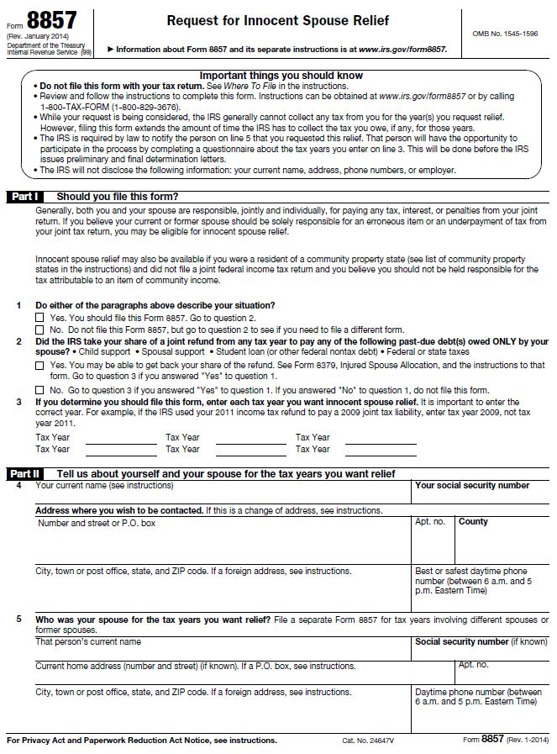
IRS Form 8857
Request for Innocent Spouse Relief
(page 1 of 7)

Slide 224
Appealing Adverse Decision
Use form 12509
IRS issues Notice of Preliminary Determination
Requesting spouse may file a protest with the Appeals Division
30-day limit
(800) 658-7590 www.taxresolutioninstitute.org

Slide 225
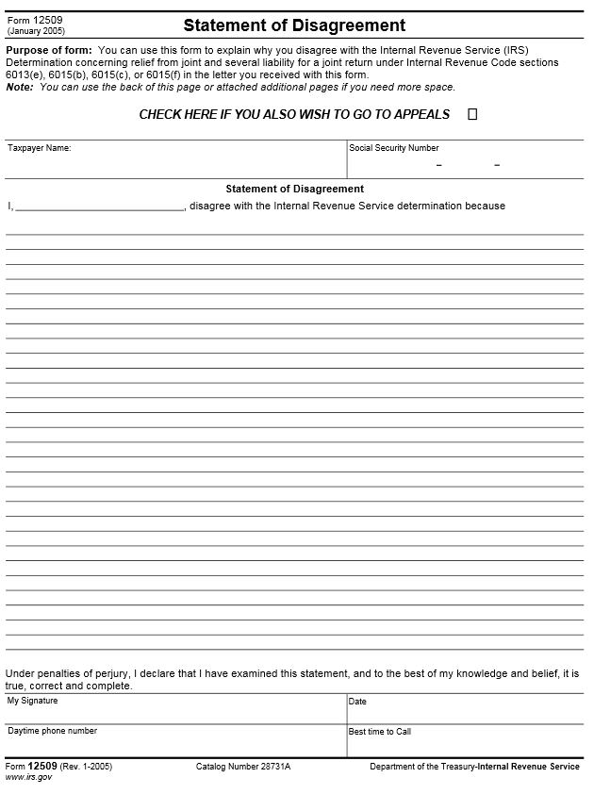
IRS Form 12509
Statement of Disagreement

Slide 226
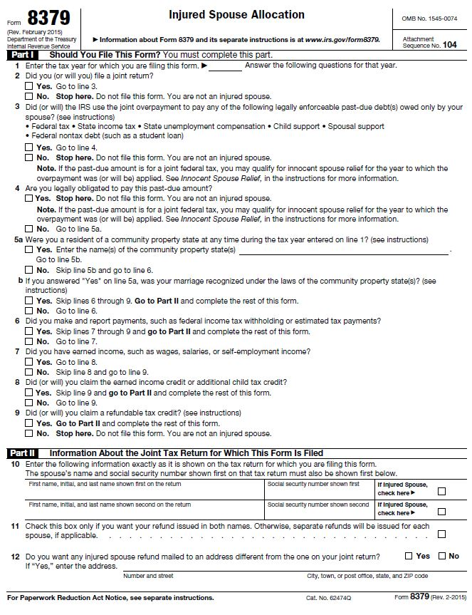
IRS Form 8379
Injured Spouse Allocation
(page 1 of 2)

Slide 227
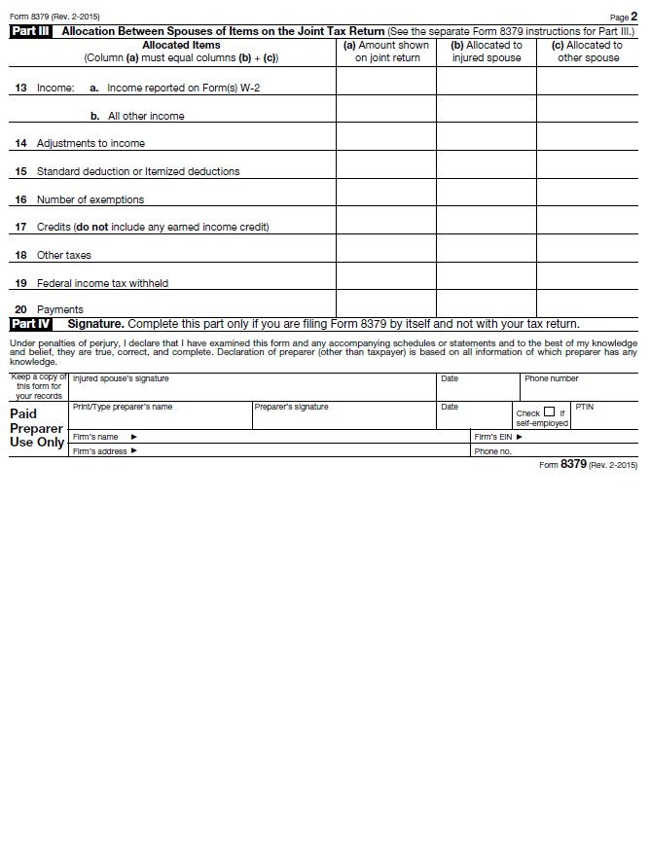
IRS Form 8379
Injured Spouse Allocation
(page 2 of 2)

Slide 228
Tax Court – Innocent Spouse Relief
Requesting spouse may file a tax court petition after Final Notice of Determination has been issued by the Appeals Division
Requesting spouse may also file a tax court petition if 6 months have passed since filing of initial request
Requesting spouse may also file a tax court petition in conjunction with a substantive deficiency determination (if requesting spouse “meaningfully participated” in the tax court case, using the innocent spouse defense may be prevented
(800) 658-7590 www.taxresolutioninstitute.org

Slide 229
Injured Spouse
You are an injured spouse if:
You file a joint return, and;
All or part of your share of the refund was or will be applied against the separate past-due federal tax, state tax, child support or federal non-tax debt (such as a student loan) of your spouse with whom you filed the joint return
If you are an injured spouse, you may be entitled to recoup your share of the refund
(800) 658-7590 www.taxresolutioninstitute.org

Slide 230
Taxes and Bankruptcy

Slide 231
Taxes and Bankruptcy
Income taxes may be discharged in bankruptcy
Certain rules (“conditions”) must be met to discharge taxes in bankruptcy
Payroll Taxes may not be discharged in bankruptcy
(800) 658-7590 www.taxresolutioninstitute.org

Slide 232
Bankruptcy Tax Dischargeability Rules:
Three-Year Rule
  At least Three years from the due date of the tax return including extensions; or
Two-Year Rule
  At least Two years from the date the tax return was filed (we say assessed) for delinquent returns; and
240-Day Rule
  At least 240 days from the date of assessment of an audited or amended tax return
(800) 658-7590 www.taxresolutioninstitute.org

Slide 233
Chapter 7 vs. Chapter 13
  Dischargeable taxes are eliminated in Chapter 7 filings
  Dischargeable taxes are treated as general, unsecured creditors in Chapter 13 filings
  Secured tax liens may not be discharged in Chapter 7 filings
(800) 658-7590 www.taxresolutioninstitute.org

Slide 234
Tolling Events (Statutes of Limitation)
Statute of Limitation for collection by the IRS tolls (is frozen and therefore extended) under the following circumstances:
    240 days; plus
    The number of days each offer in compromise for the applicable tax had been pending; plus
    30 days for each applicable offer in compromise; plus
    The number of days each prior bankruptcy proceeding had been pending after the related tax return due date with valid extensions; plus
    Six months for each applicable bankruptcy proceeding
    The period of time taxpayer spends living outside the country

Slide 235
Low Hanging Fruit #4
    Prepare a tax dischargeability analysis
    Earn $1,500 – 4,000

Slide 236
    Tax Dischargeability Analysis
What is a Tax Dischargeability Analysis (TDA)?
This is an analysis used to determine if and when income taxes may be dischargeable in bankruptcy based upon conditions including the 3-year rule, the 2-rule, the 240-day rule and tolling events.

Slide 237
    Tax Dischargeability Analysis
Things to consider…
Were the tax returns filed timely?
Did the IRS prepare substitutes for returns (SFR’s)?
How much time has passed since the return/s were filed?
Were the tax return/s amended?
Was there a previous installment agreement?
Was a CAP, CDP or other type of appeal filed?

Slide 238
    Tax Dischargeability Analysis
More things to consider…
Was an offer in compromise submitted?
Was the taxpayer out of the country for an extended period of time?
Did the taxpayer file a previous bankruptcy?
Were the tax return/s amended?

Slide 239
Story Time
A “Slam Dunk” isn’t always the best choice…
“Al” – Owed $4 Million to IRS, $400K to State, 70 years old
So what happened? Settled for…
$5,000 to the IRS
$17,000 to the State
$10,000 in fees
Moral
A good result but should have filed for bankruptcy
(800) 658-7590 www.taxresolutioninstitute.org

Slide 240
Again..
Why you need to market, sell and practice tax resolution
Regular tax returns are a commodity. You make between $400 and $1,000 for normal return
Each resolution case runs from $4000 – $10,000 (ten times the amount for tax returns)
Using a system, this work is easy and manageable
Setting up shop yields immediate results

Slide 241
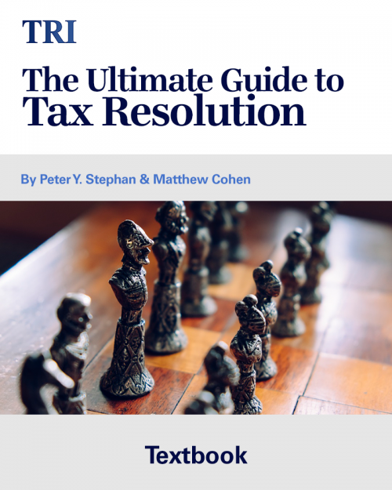
This book is a must for tax resolution practitioners….
Afternoon Break
50% off
Available in both hard cover and pdf versions
Hardcover: $149.00 $74.50
PDF: $99.00 $49.50

Slide 242
Audits

Slide 243
Audit Topics
How many IDR’s are too many?
What is a 30-day letter?
What is a 90-day letter?
If 90 days has passed how to get another “bite at the apple”
Fast-Track Settlement (FTS)
Fast-Track Mediation (FTM)
243
(800) 658-7590 www.taxresolutioninstitute.org

Slide 244
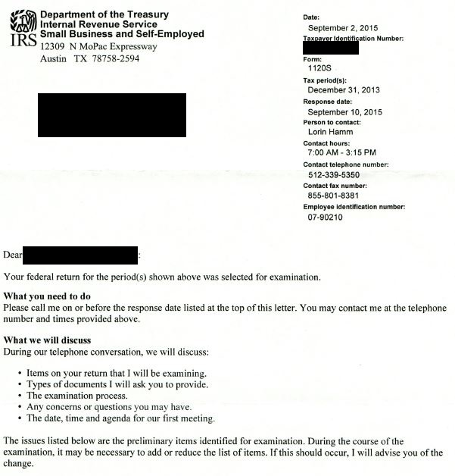
EXAMINATION LETTER
IRS Form 2205-A

Slide 245
Information Document Requests
IRS Form 4564
Known as IDR’s
May be accompanied by one or more Summons
How many IDR’s are too many?
245
(800) 658-7590 www.taxresolutioninstitute.org

Slide 246
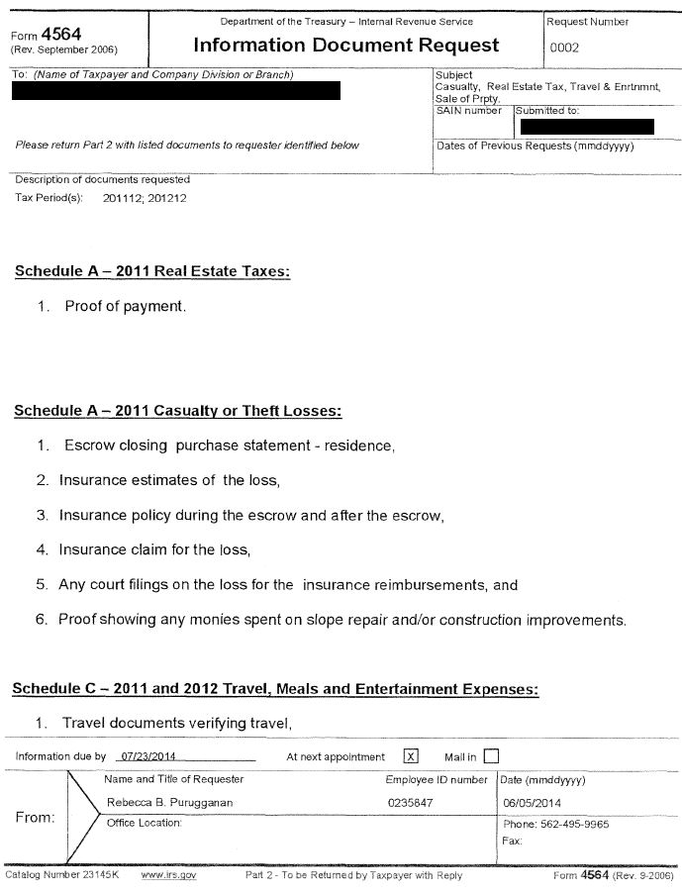
IRS IDR
Form 4564
(page 1 of 4)

Slide 247
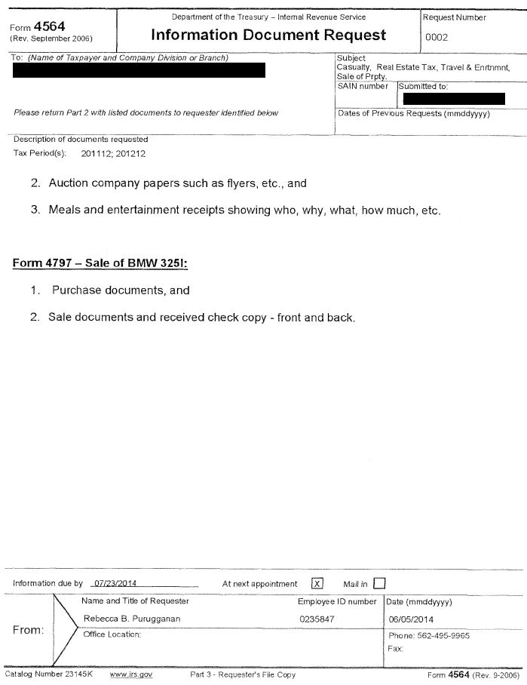
IRS IDR
Form 4564
(page 2 of 4)

Slide 248
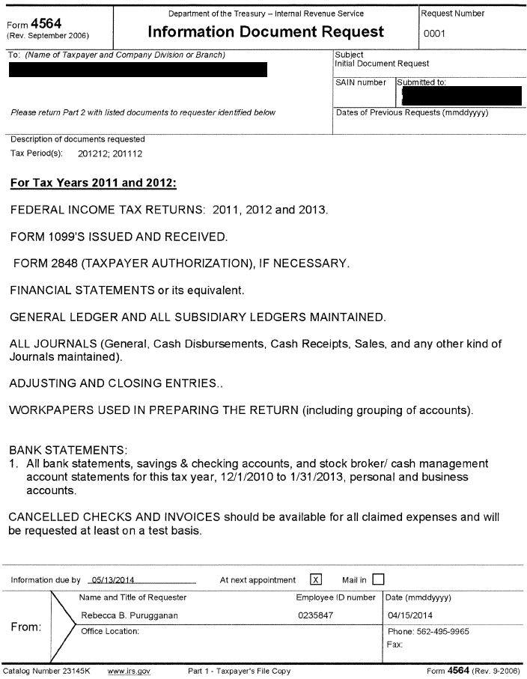
IRS IDR
Form 4564
(page 3 of 4)

Slide 249
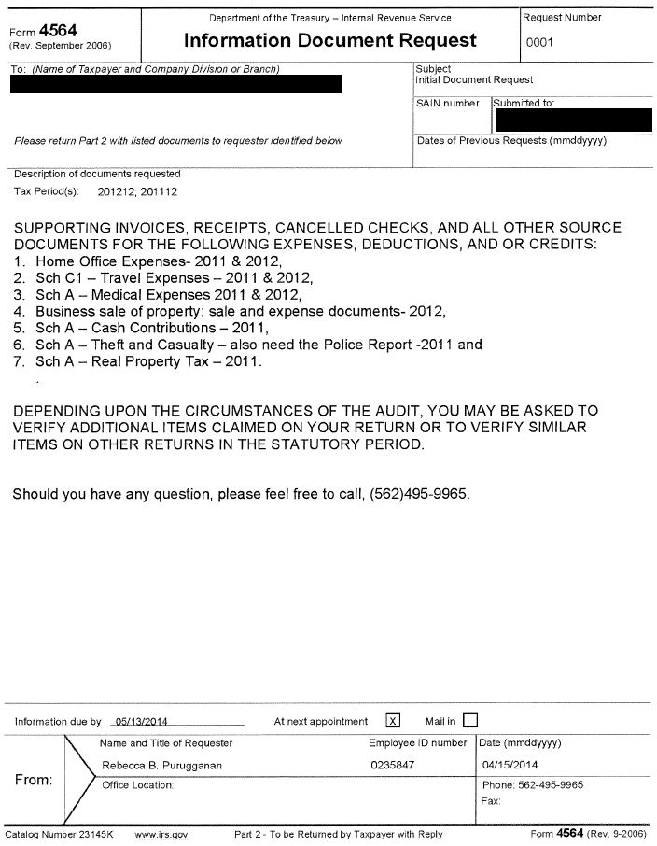
IRS IDR
Form 4564
(page 4 of 4)

Slide 250
Audit Time
So the audit appointment is set…
Practical steps…
Request (or review received) IDR
Obtain documents, ledgers and other related substantiation from the client
Do a “mini” audit – remember you want to know the results of the audit before the Revenue Agent walks in the door
250
(800) 658-7590 www.taxresolutioninstitute.org

Slide 251
Practical Steps
(continued)
Have a staff person (preferably on the POA) meet and greet the auditor first
Do not be available for the first 30 minutes (or more if necessary)
Guide the auditor to examine best documented items first regardless of the order of his requests
Meet & greet the auditor, apologize for being late and ask if your staff person got him or her started okay
Ask if he or she requires additional documents, leave the room to obtain them
251
(800) 658-7590 www.taxresolutioninstitute.org

Slide 252
Audit Findings
Provided in IRS Form 4549
Taxpayer may accept changes as proposed
Taxpayer may appeal assessment at the audit level
Taxpayer may appeal assessment at the court level
Taxpayer may get a 2nd “bite at the apple” via an offer in compromise
252
(800) 658-7590 www.taxresolutioninstitute.org

Slide 253
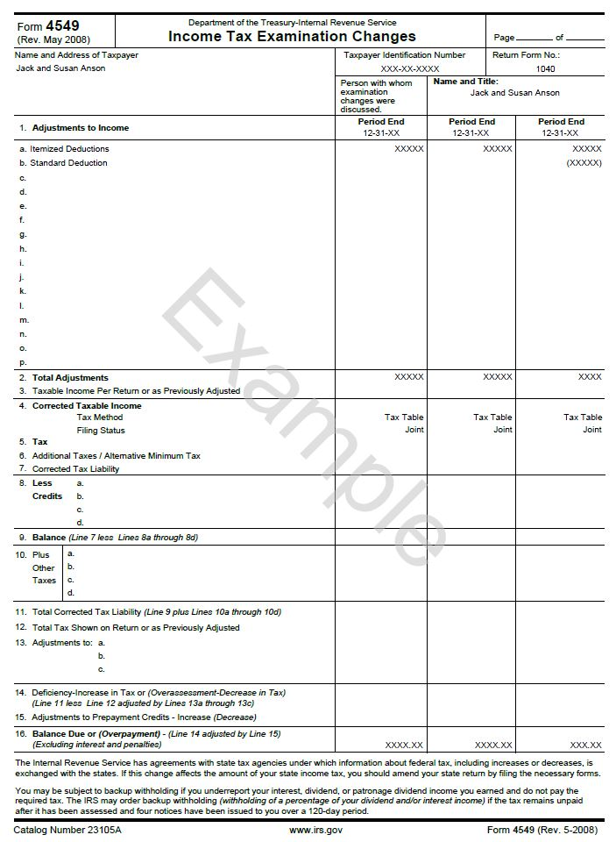
IRS Form 4549
Income Tax Changes
(page 1 of 2)

Slide 254
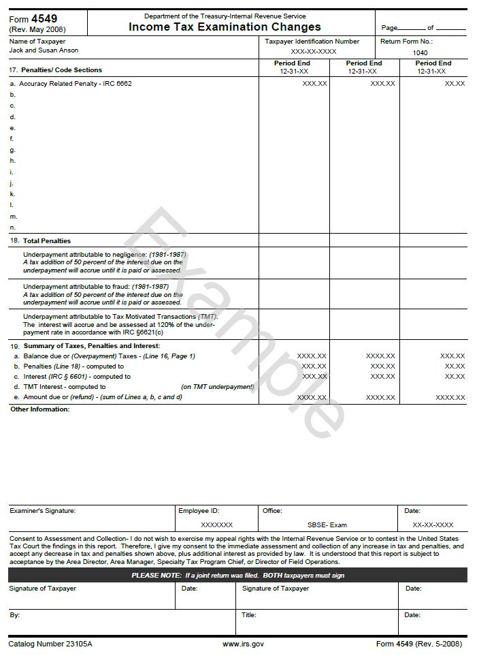
IRS Form 4549
Income Tax Changes
(page 1 of 2)

Slide 255
30-Day Letter
IRS Letter 950
Federal income tax audit concluded
Revenue Agent’s Report (RAR) has been issued outlining proposed changes
May be bypassed if time remaining on the statute of limitations is insufficient
255
(800) 658-7590 www.taxresolutioninstitute.org

Slide 256
30-Day Letter continued
Options
Accept and pay proposed liability
Appeal findings
Do nothing in anticipation of receiving Notice of Deficiency (90-day letter)
256
(800) 658-7590 www.taxresolutioninstitute.org

Slide 257
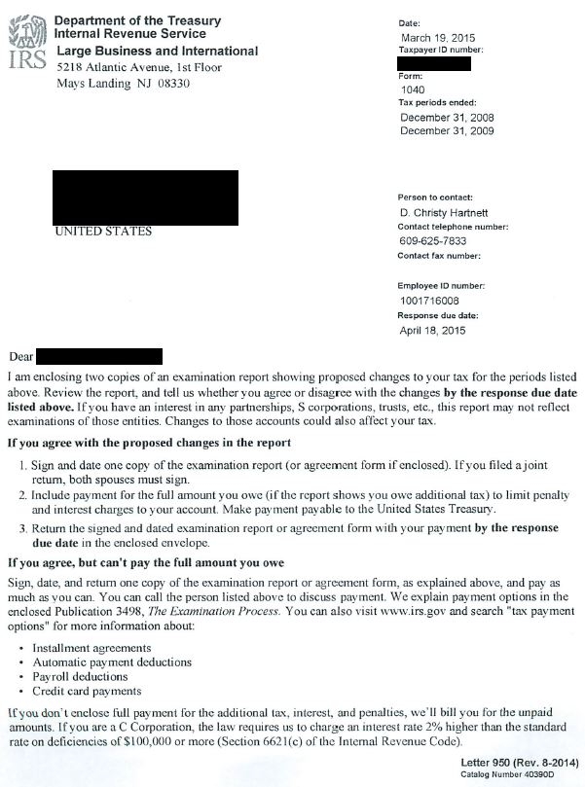
IRS
30-Day Letter
(page 1 of 2)

Slide 258
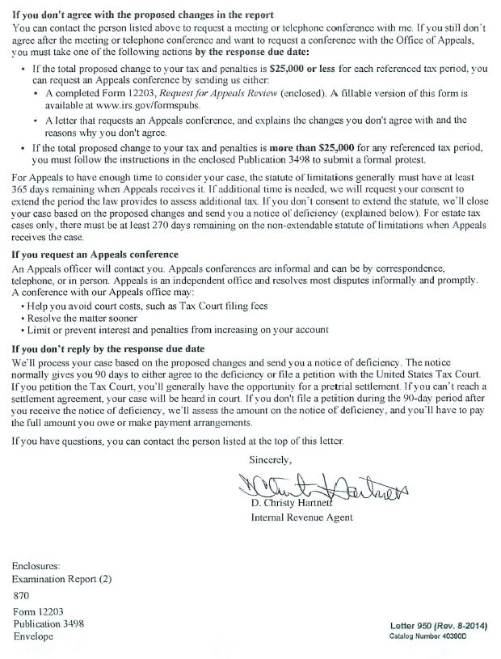
IRS
30-Day Letter
(page 2 of 2)

Slide 259
Things to Note
Revenue agents have very limited authority
Appeals officers consider the government’s perceived hazards of litigation stemming from an appeal or tax court petition filing increases chances of settlement
259
(800) 658-7590 www.taxresolutioninstitute.org

Slide 260
90-Day Letter
IRS Letter 937
Also referred to as a Notice of Deficiency
Must respond within 90 days in order to take appeal to tax court
260
(800) 658-7590 www.taxresolutioninstitute.org

Slide 261

IRS
90-Day Letter
(page 1 of 6)

Slide 262
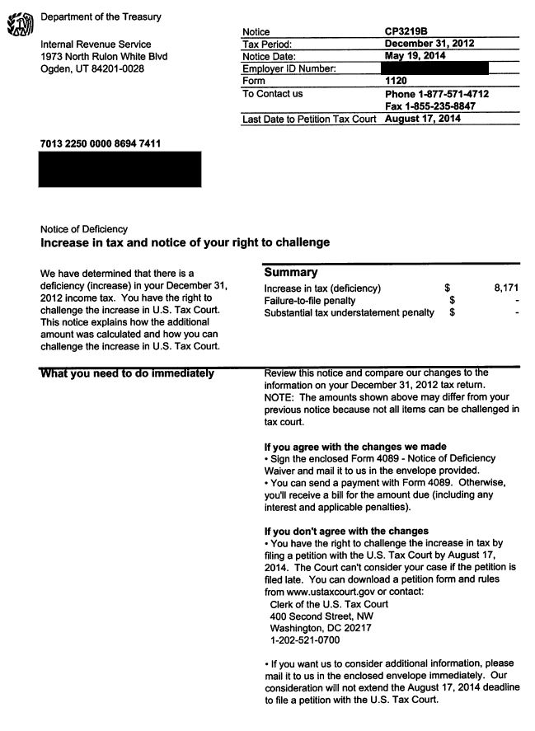
IRS
90-Day Letter
(page 2 of 6)

Slide 263
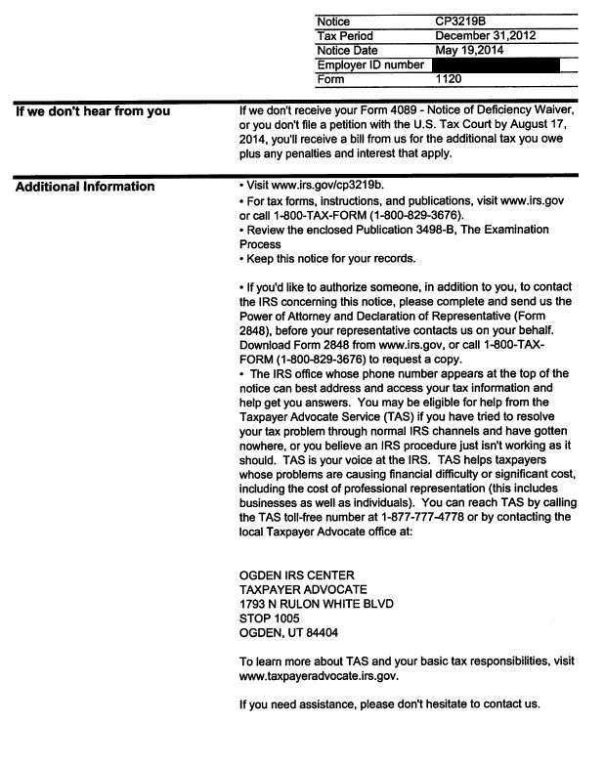
IRS
90-Day Letter
(page 3 of 6)

Slide 264
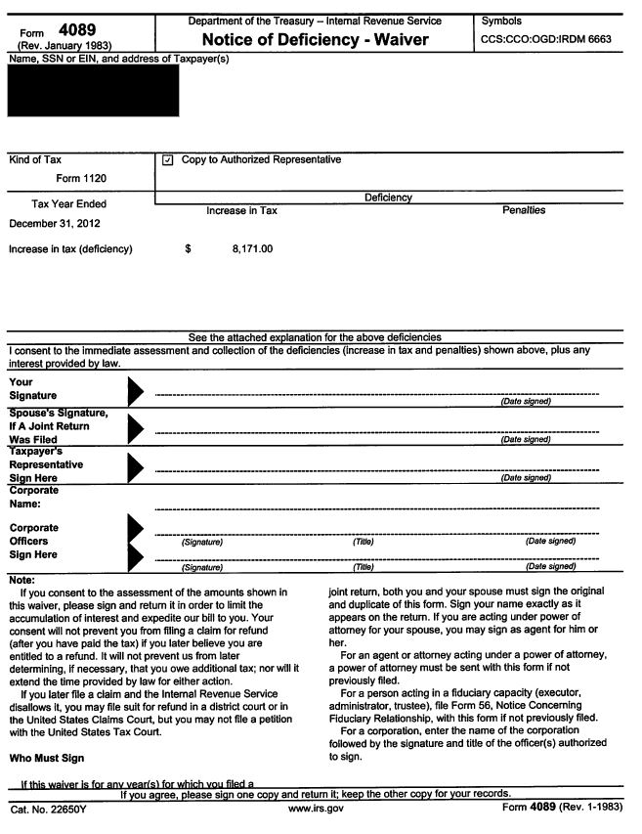
IRS
90-Day Letter
(page 4 of 6)

Slide 265
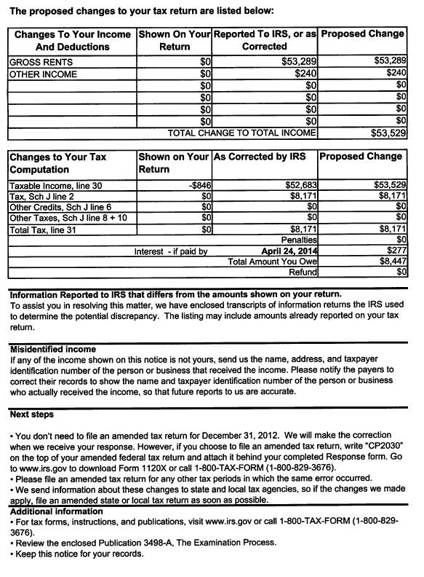
IRS
90-Day Letter
(page 5 of 6)

Slide 266
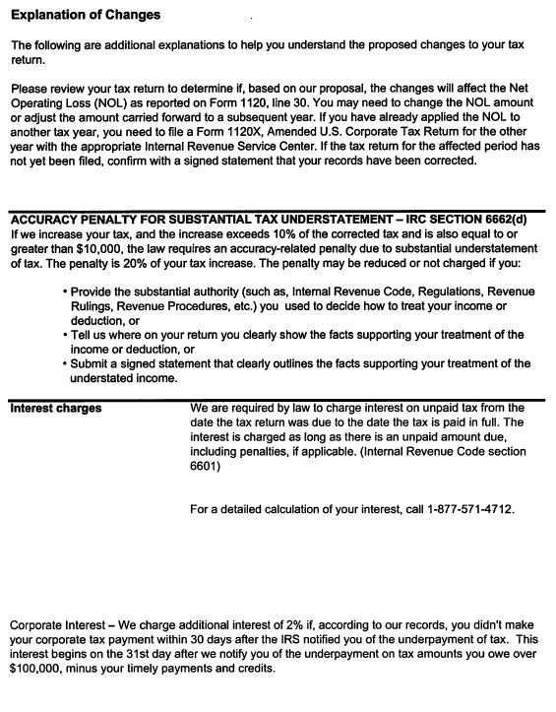
IRS
90-Day Letter
(page 6 of 6)

Slide 267
Deals for today’s participants…
50% off Textbook
75% off TRI’s Ultimate Professional’s SystemTM
Free 2-month VIP membership
Go to www.taxresolutioninstitute.org (a link is being pushed to you now)
Take advantage before 6pm today
DAVID TO PUSH LINK
267
access your free content at www.taxresolutioninstitute.org/200A

Slide 268
Questions & Answers
TRI VIP Member ProgramTM
get two month’s free
*Offer good until 6pm today
TELL DAVID TO PUSH LINK
268
(800) 658-7590 www.taxresolutioninstitute.org

Slide 269
Appeals

Slide 270
Appeal Topics
Overview
Collection Appeal Rights
  Collection Due Process (“CDP”) Form 12153
  Collection Appeals Process (“CAP”) Form 9423
Offer in Compromise Appeal
Request for Mediation
Fast Track Settlement
Taxpayer Advocate
270
(800) 658-7590 www.taxresolutioninstitute.org

Slide 271
Collection Appeal Rights
Two options…
Collection Due Process (“CDP”) Form 12153
Collection Appeals Process (“CAP”) Form 9423
271
(800) 658-7590 www.taxresolutioninstitute.org

Slide 272
CAP (Form 9423) |  | CDP (Form 12153)
Levy or seizure action that has been or will be taken |  | Notice of Intent to Levy and Notice of Your Right to Hearing
A Notice of Federal Tax Lien (NFTL) that has been or will be filed |  | Notice of Federal Tax Lien Filing and Your Right to Hearing under IRC 6320
The filing of a notice of lien against an alter-ego or nominee’s property |  | Notice of Jeopardy Levy and Right to Appeal
Denials of requests to issue lien certificates, such as subordination, withdrawal, discharge or non-attachment |  | Notice of Levy on Your State Tax Refund
Rejected, proposed for modification or modified, or proposed for termination or terminated installment agreements |  | Notice of Levy and Notice of Your Right to a Hearing
Disallowance of taxpayer’s request to return levied property under IRC 6343(d) |  | You may petition the Tax Court post findings
Disallowance of property owner’s claim for return of property under IRC 6343(b) |  | Process takes significantly more time to reach a result than filing a CAP

Slide 273
Similarities
You may represent yourself
You may be represented by an attorney
You may be represented by a CPA
You may be represented by any other person enrolled to practice before the IRS
You may be represented by immediate family
For businesses you may be represented by employees, partners or officers
273
(800) 658-7590 www.taxresolutioninstitute.org

Slide 274
Differences
You may go to court if you disagree with results of CDP hearing
You may not go to court following a CAP hearing
CAP results come in a relatively short period of time
274
(800) 658-7590 www.taxresolutioninstitute.org

Slide 275
Collection Due Process
IRS FORM 12153
Request for a Collection Due Process or Equivalent Hearing
275
(800) 658-7590 www.taxresolutioninstitute.org

Slide 276
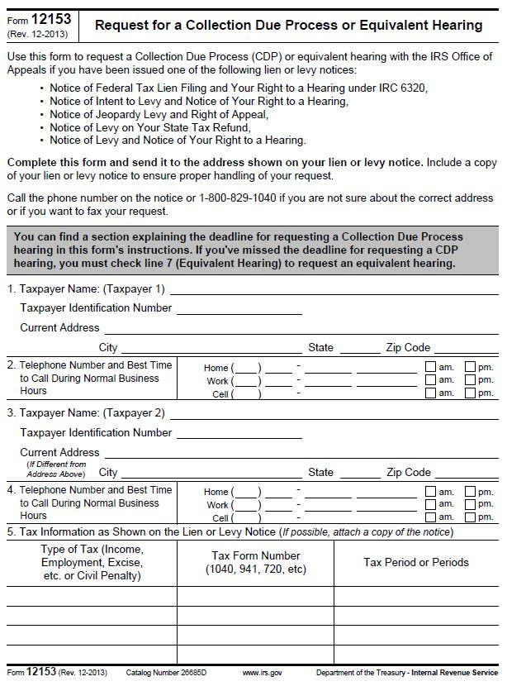
IRS Form 12153
CDP
(page 1 of 2)

Slide 277
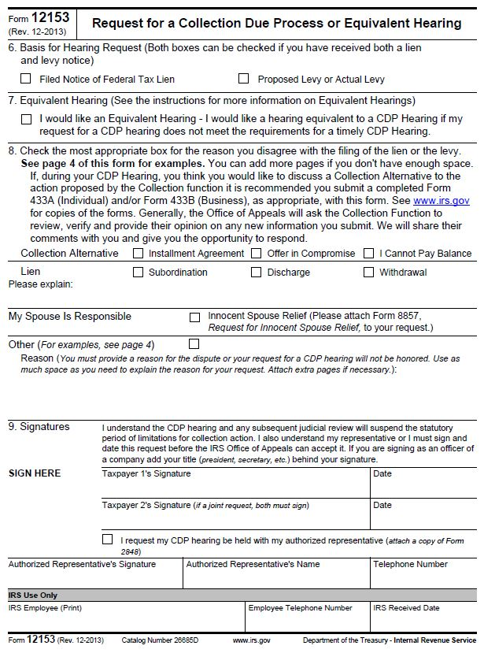
IRS Form 12153
CDP
(page 2 of 2)

Slide 278

What to do… when things get tough
Join the TRI VIP Member ProgramTM
DAVID TO PUSH LINK
Ultimate Level
Two-months free when you attend the 200A Seminar or Webcast
This program shows you how to fix the problem when most think they’re done!
…don’t get left behind
*offer expires at 8pm tonight

Slide 279
Collection Appeal Rights
IRS FORM 9423
Collection Appeal Request
279
(800) 658-7590 www.taxresolutioninstitute.org

Slide 280
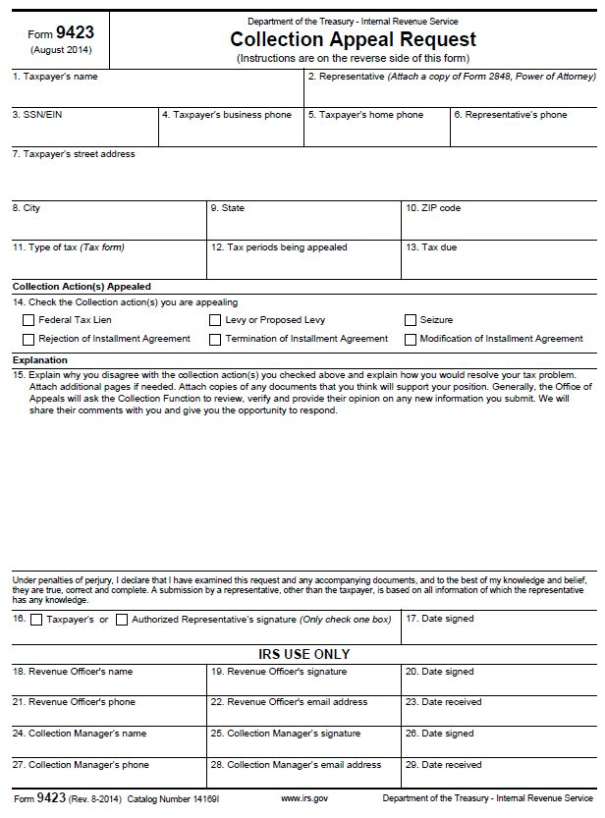
IRS Form 9423
CAP

Slide 281
Fast Track Settlement and
Mediation
(income tax audits)
281
(800) 658-7590 www.taxresolutioninstitute.org

Slide 282
Purpose
To provide a quicker result for tax examinations
Involves Appeals Officer sooner than otherwise may happen
Either IRS or taxpayer may request either process
Both parties must agree in order to begin either process
282
(800) 658-7590 www.taxresolutioninstitute.org

Slide 283
Fast Track Settlement
Use form 14017
Entire process should be less than 60 days
Can be initiated at the appeals level
Mediator considers hazards of litigation
Neither the taxpayer nor the IRS (via examining agent) are obligated to accept the mediator’s proposal.
283
(800) 658-7590 www.taxresolutioninstitute.org

Slide 284
Fast Track Settlement
IRS FORM 14017
Application for Fast Track Settlement
284
(800) 658-7590 www.taxresolutioninstitute.org

Slide 285
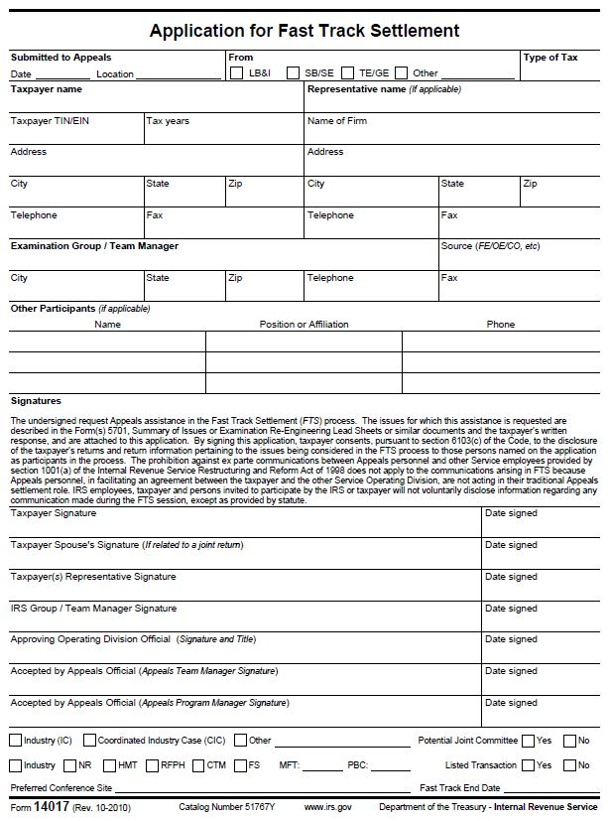
IRS Form 14017 Application for Fast Track Settlement

Slide 286
Fast Track Mediation
Use form 13369
Mediator only views items at the examination level
CANNOT be initiated at the appeals level
Neither the taxpayer nor the IRS (via examining agent) are obligated to accept the mediators proposal.
286
(800) 658-7590 www.taxresolutioninstitute.org

Slide 287
Fast Track Mediation
IRS FORM 13369
Agreement to Mediate
287
(800) 658-7590 www.taxresolutioninstitute.org

Slide 288
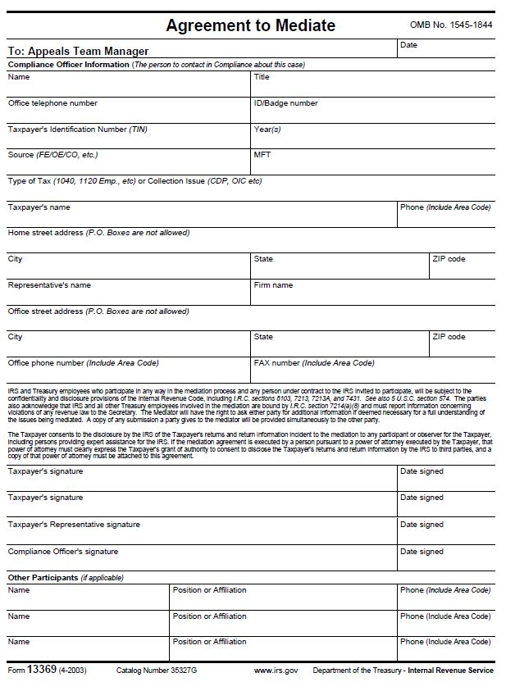
IRS Form 13369
Agreement to Mediate

Slide 289
Taxpayer Advocate
Use form to request Taxpayer Advocate Service (TAS) assistance when:
Taxpayer’s problem with IRS is causing financial difficulties to taxpayer, taxpayer’s family or taxpayer’s business
Taxpayer or taxpayer’s business is facing an immediate threat or adverse action
Taxpayer has tried repeatedly to contact the IRS, but no one has responded, or the IRS has no responded by the date promised
If TAS does not respond within 1 week, contact TAS office via telephone
289
(800) 658-7590 www.taxresolutioninstitute.org

Slide 290
Taxpayer Advocate
IRS FORM 911
Request for Taxpayer Advocate
290
(800) 658-7590 www.taxresolutioninstitute.org

Slide 291
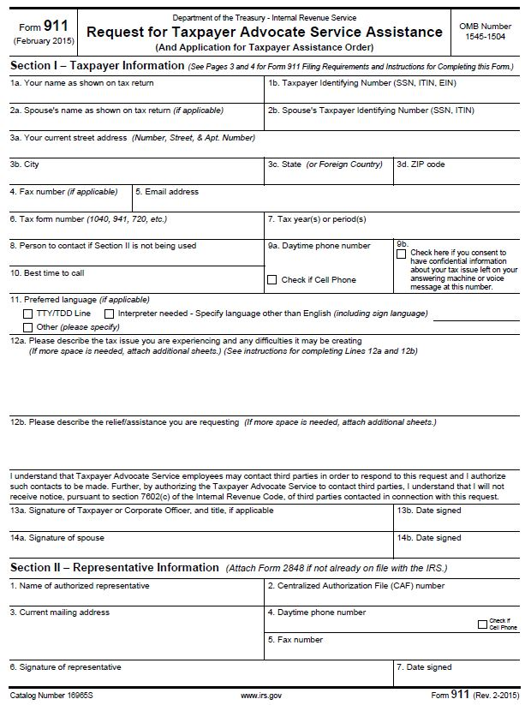
IRS Form 911 Request for Taxpayer Advocate
(page 1 of 2)

Slide 292
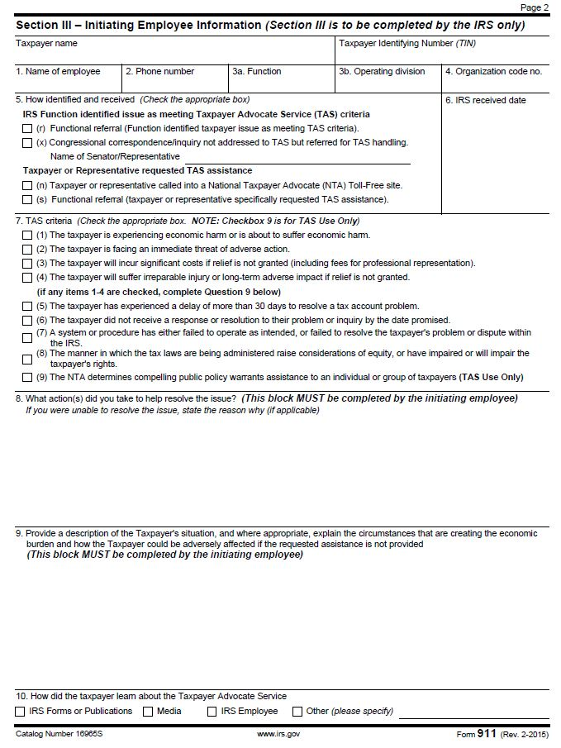
IRS Form 911 Request for Taxpayer Advocate
(page 2 of 2)

Slide 293
FAQ’s
Installment Agreements – what should I do if my client qualifies for a streamlined installment agreement but is unable to afford the monthly payment amount?
2. Offer in Compromise – can my client who has been assessed a Civil Penalty stemming from the Trust Fund portion of payroll tax liability submit an offer?
3. Bankruptcy – if my client filed their 2009 tax return on June 15, 2010 which was on extension, can they file for bankruptcy on June 16, 2013 and discharge their 2009 tax liability under the 3-year rule?
4. Appeals – which type of appeal, CAP or CDP allows you to make an argument in tax court? (Stay tuned for the next webinar…)

Slide 294
Tax Court
a brief look …
294
(800) 658-7590 www.taxresolutioninstitute.org

Slide 295
Tax Court
Advantages
Change of a favorable result to taxpayer has a high probability
Over 90% of tax court cases reach settlement prior to trial
295
(800) 658-7590 www.taxresolutioninstitute.org

Slide 296
Tax Court
Disadvantages
You cannot go to tax court if you have already paid the tax in question
Tax court meets infrequently and a result will take a long time
Trial is typically calendared more than 6 months from the time a petition is filed
Small cases often take a year to decide
296
(800) 658-7590 www.taxresolutioninstitute.org

Slide 297
Tax Court
Types of Tax Court
297
(800) 658-7590 www.taxresolutioninstitute.org

Slide 298
Tax Court
Small Tax Court (S Case) Proceedings
Cases sent to Office of Appeals
Cases can not exceed liability of $50,000 per year
Nominal filing fee
Taxpayer will receive notice of trial, standing pre-trial order and trial memorandum
IRS counsel may request meeting to discuss the case
298
(800) 658-7590 www.taxresolutioninstitute.org

Slide 299
Tax Court
Small Tax Court (S Case) Proceedings
Burden of proof is on the taxpayer
Judge may render decision at trial or by mail
Court will send bill for remaining taxes
Legal briefs typically not necessary
Findings can not be appealed to Court of Appeals
299
(800) 658-7590 www.taxresolutioninstitute.org

Slide 300
Tax Court
Regular Tax Court Proceedings
Most cases settle before trial
Nominal filing fee
Requires submission of legal briefs by IRS and taxpayer
May request reclassification as an S Case if taxpayer is willing to waive right to contest tax assessed above $50,000
300
(800) 658-7590 www.taxresolutioninstitute.org

Slide 301
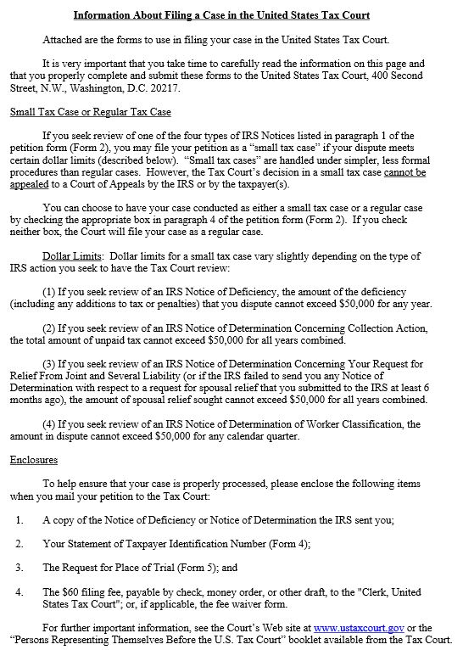
US Tax Court Petition Package
(page 1 of 5)

Slide 302
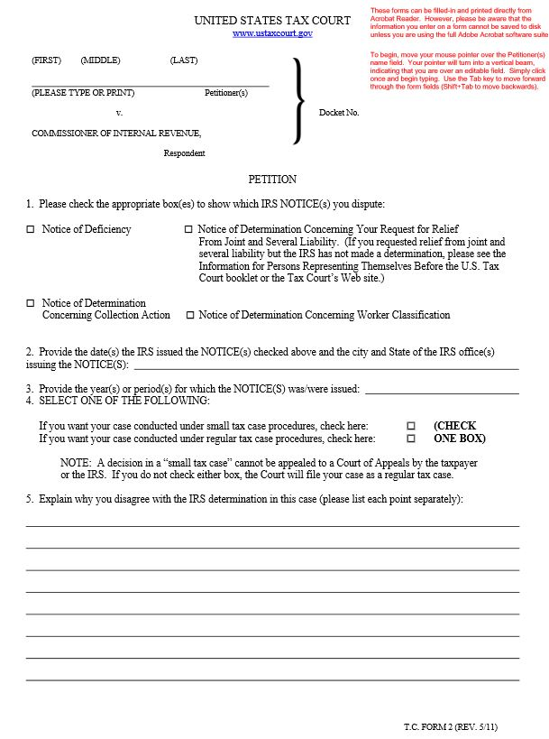
US Tax Court Petition Package
(page 2 of 5)

Slide 303

US Tax Court Petition Package
(page 3 of 5)

Slide 304
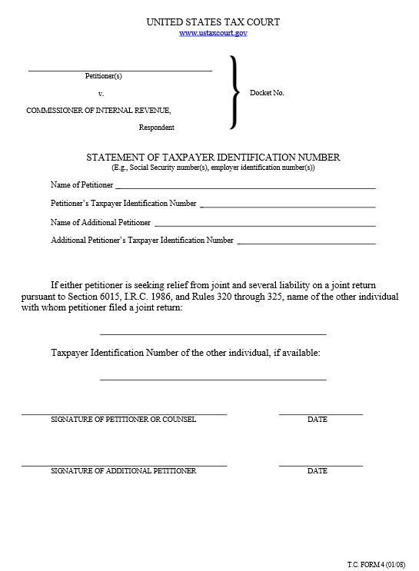
US Tax Court Petition Package
(page 4 of 5)

Slide 305
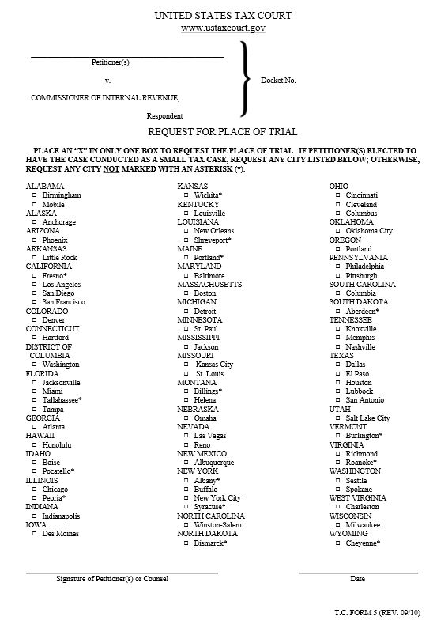
US Tax Court Petition Package
(page 5 of 5)

Slide 306
Tax Court
Who can file a petition?
Any person who has received a notice of deficiency
Any person who has received a notice of determination
In some instances a petition may be filed for relief from joint and several liability (innocent spouse relief)
306
(800) 658-7590 www.taxresolutioninstitute.org

Slide 307
Tax Court
Who can appear in tax court?
A private attorney
A non-attorney admitted to practice in tax court
A taxpayer without representation
307
(800) 658-7590 www.taxresolutioninstitute.org

Slide 308
Summary of topics covered today
Tax Cuts and Jobs Act
Grow your practice with Tax Resolution
Marketing for professionals
Gave away Professional’s System
Resolution case management
Payroll Taxes
Installment agreements
Case study: installment agreement
Offers in compromise
Selling your professional services
Gave away Professional’s System
Case study: OIC vs IA
IRS criminal investigation
Innocent Spouse
Taxes and bankruptcy
Audits
Appeals
308
(800) 658-7590 www.taxresolutioninstitute.org

Slide 309
Our mission today…
To give participants lots of FREE STUFF
(see your chat box for the link)
Teach you how to become a tax resolution specialist;
Teach you how to make money
Become your tax resolution partner; or
Become your trusted referral source
Find us on the web at: www.taxresolutioninstitute.org
Email us at: info@taxresolutioninstitute.com
Call us at: (800) 658-7590

Slide 310
TRI Tax Tuesdays…
I
Tax Tuesdays
    Free courses
    Free materials
    Practitioner’s forum
    Featured courses
    Huge discounts
    Lightning deals
    EVERY TUESDAY
TM
Visit www.taxresolutioninstitute.org to see upcoming offers…

Slide 311
Deals for today’s participants…
50% off Textbook
75% off TRI’s Ultimate Professional’s SystemTM
Free 2-month VIP membership
Go to www.taxresolutioninstitute.org (a link is being pushed to you now)
Take advantage before 6pm today
TELL DAVID TO PUSH LINK
311
access your free content at www.taxresolutioninstitute.org/200A

Slide 312
We are your one-stop shop for all tax resolution, accounting, tax and consulting needs
TRI
Tax Resolution Institute
SST CPAS INC
Certified Public Accountants
Find us on the web at
www.taxresolutioninstitute.org
Email us at
info@taxresolutioninstitute.org
Call us at
(800) 747-8718 (310) 789-3202 (818) 704-1443
(800) 747-8718 / (818) 704-1443 /
(310) 789-3202
www.taxresolutioninstitute.org

Slide 313
Take Advantage Today
Morning Break
Sales & Marketing
75%off
$750
Only good until 6pm today
add the
Resolution Add-on Pack
for only $100 More
(a $500 value!)
DAVID TO PUSH LINK
Charge up to 2 times your normal rate
Keep busy all year long
Solve even the most complex tax collection problems with our VIP ProgramTM
Find clients without spending too much time or too much money
Close a deal with little to no effort
$3,000.00

